Slide 1
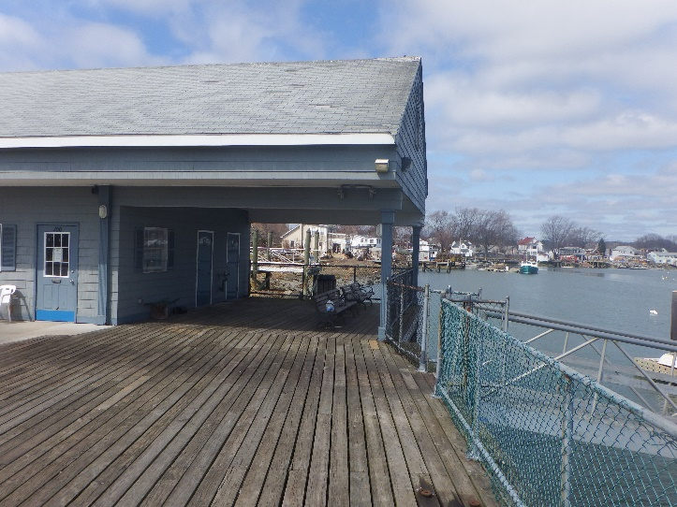
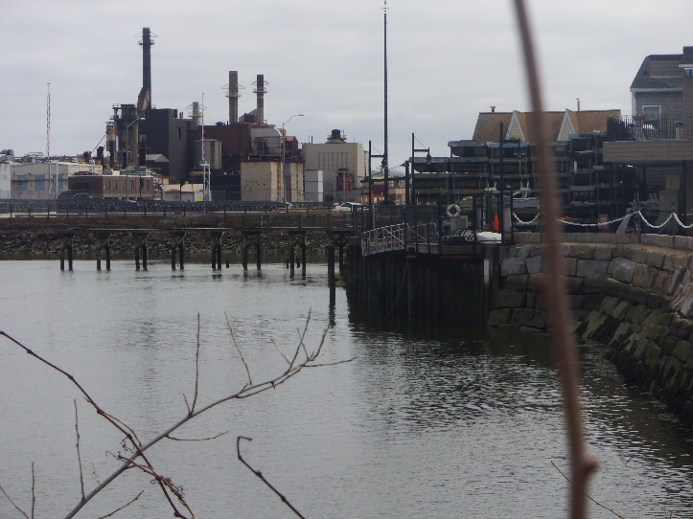
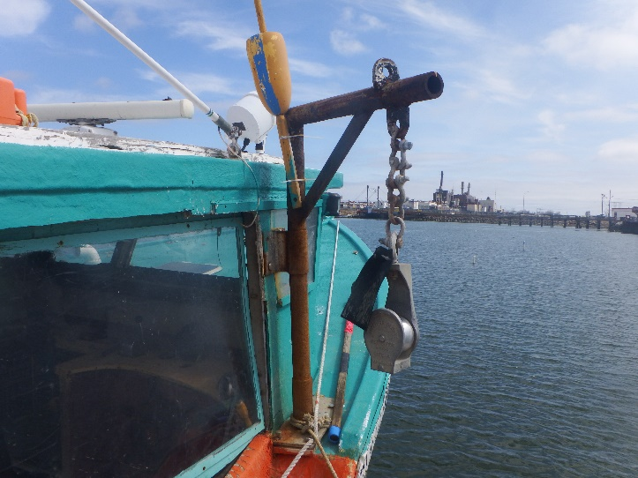
SAUGUS RIVERWALK
NOTICE OF INTENT APPLICATION
PREPARED BY: Apex Companies, LLC and LEC Environmental, Inc.
for Town of Saugus

Slide 2
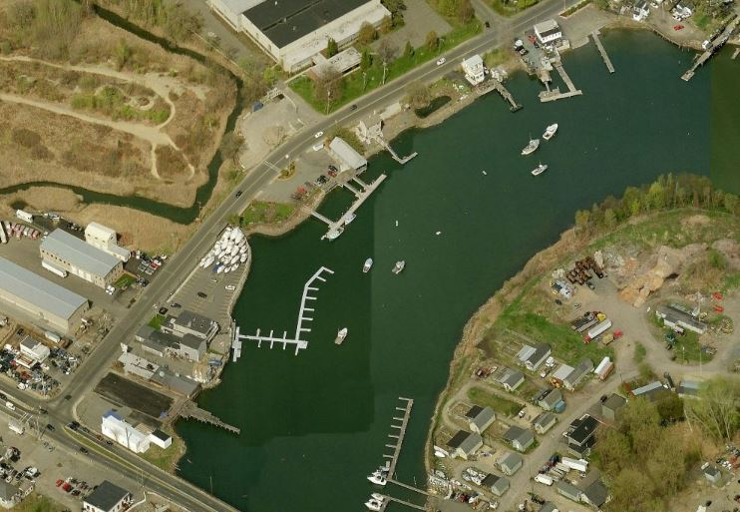
Introduction & Agenda
Purpose
Project History
Project Area
Locations for Access
Alternatives
Proposed Project
Benefits
Environmental Impacts
Benefits
Conclusion

Slide 3
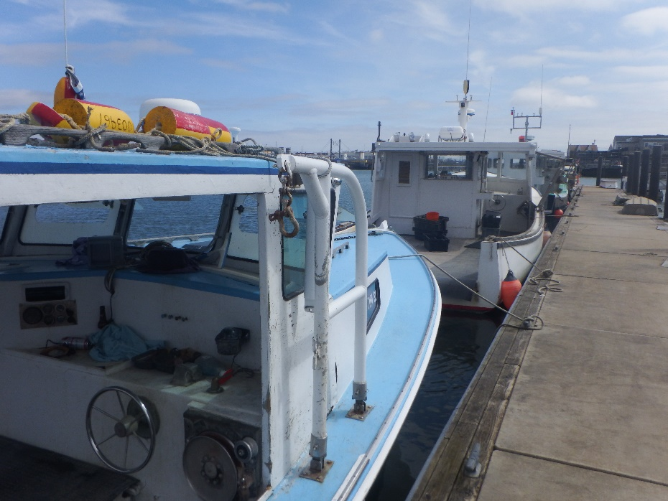
Purpose
This Project is presented by:
The Town of Saugus
Apex Companies, LLC
CR Associates, Inc.
LEC Environmental, Inc.
Funding provided by the Massachusetts Seaport Economic Council to lay out, plan and commence design of a pedestrian path along the Saugus River banks
Provide improved waterside access to the Public
Promote and encourage visitors and commercial activity along the River
Provide for a safe pedestrian crossing to the DCR’s restoration of the Rumney Marsh ACEC
Notes:
Apex has been working with CR Associates, Inc. and the Town of Saugus through funding provided by the Massachusetts Seaport Economic Council to lay out, plan and commence design of a pedestrian path along the Saugus River banks
The RiverWalk is envisioned to provide direct waterside access wherever possible as well as pinpoint locations for future access upon build-out under the overlay zoning
The RiverWalk plan will also provide for a safe pedestrian crossing to the area of Department of Conservation and Recreation’s restoration of the Rumney Marsh ACEC together with its pathways and pedestrian access bridge

Slide 4
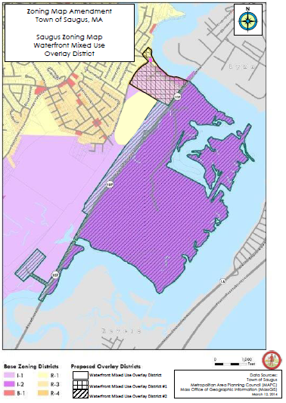
Project History
The first iron mill in the United States, the Saugus Ironworks, was established on the banks of the Saugus River in the 1600’s
Home to a small fleet of lobstermen
In 2013, the Towns’ EDC held public planning sessions that resulted in a common shared vision of the need to create a Riverwalk
The 2014 Massachusetts Environmental Bond Bill contained a line item of $1,750,000 for “Waterfront Improvements in the Town of Saugus
In 2016, The Town of Saugus received funding from Seaport Economic Council to create a local maritime economic development plan for the RiverWalk
Recently, Town Meeting overwhelmingly approved local match funds for the project
Notes:
The first iron mill in the United States, the Saugus Ironworks, was established on the banks of the Saugus River in the 1600’s
The Town has also long been home to a small fleet of lobsterman who base their operations at the Town’s Lobstermen’s Landing
In 2013, the Towns’ Economic Development Committee launched a series of visioning sessions in which the public was invited to help craft a plan for the Saugus River waterfront and at the conclusion of that process, there was a common shared vision of the need to create a Riverwalk
The Town believes the time has now come to definitively plan the Saugus RiverWalk and to assemble the resources necessary to build it
In recognition of the importance of this initiative, The 2014 Massachusetts Environmental Bond Bill contained a line item of $1,750,000 for “Waterfront Improvements in the Town of Saugus: Provided further that $1,750,000 shall be made available for design permitting and construction, including pertinent dredging, for the first phase of a River Walk along the Saugus waterfront near Route 107 in the Town of Saugus. The River Walk will increase public recreational access to the waterfront, will enhance tourism in the region and will support prospective water transportation.”
The Town of Saugus applied for and received additional funding from Seaport Economic Council in 2016 to create a local maritime economic development plan will provide the Town of Saugus with an action plan and a road map to the creation of a distinctive RiverWalk
Saugus believes business opportunities exist for greater direct retail sales of the lobster catch, for cafes and restaurants filling the tourist/visitor demand for fresh lobster and other seafood dishes, and for retail shops carrying goods and gifts with a maritime theme centered around lobstering

Slide 5
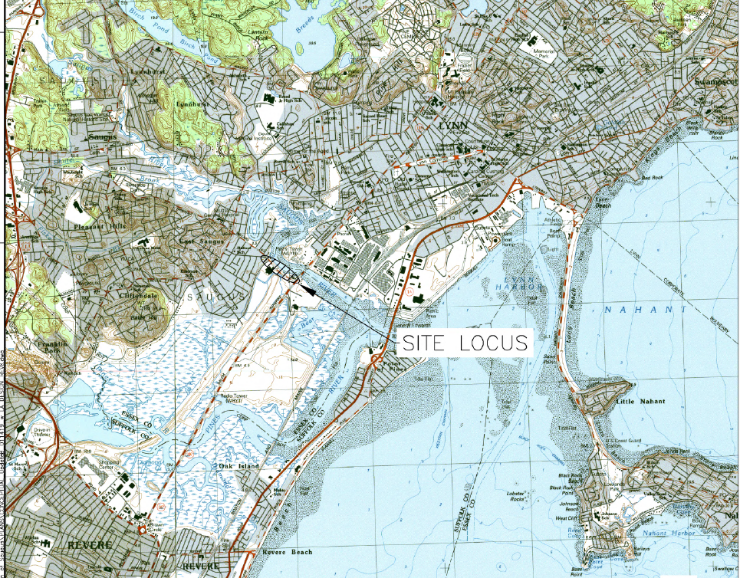
Project Area
The Saugus River is an Outstanding Resource Water and separates Saugus from Lynn
The project area is part of the Rumney Marsh Area of Critical Environmental Concern
Notes:
Ballard Street runs along the southwestern bank of the Saugus River. The project area is adjacent to the Rumney Marsh Area of Critical Environmental Concern.

Slide 6
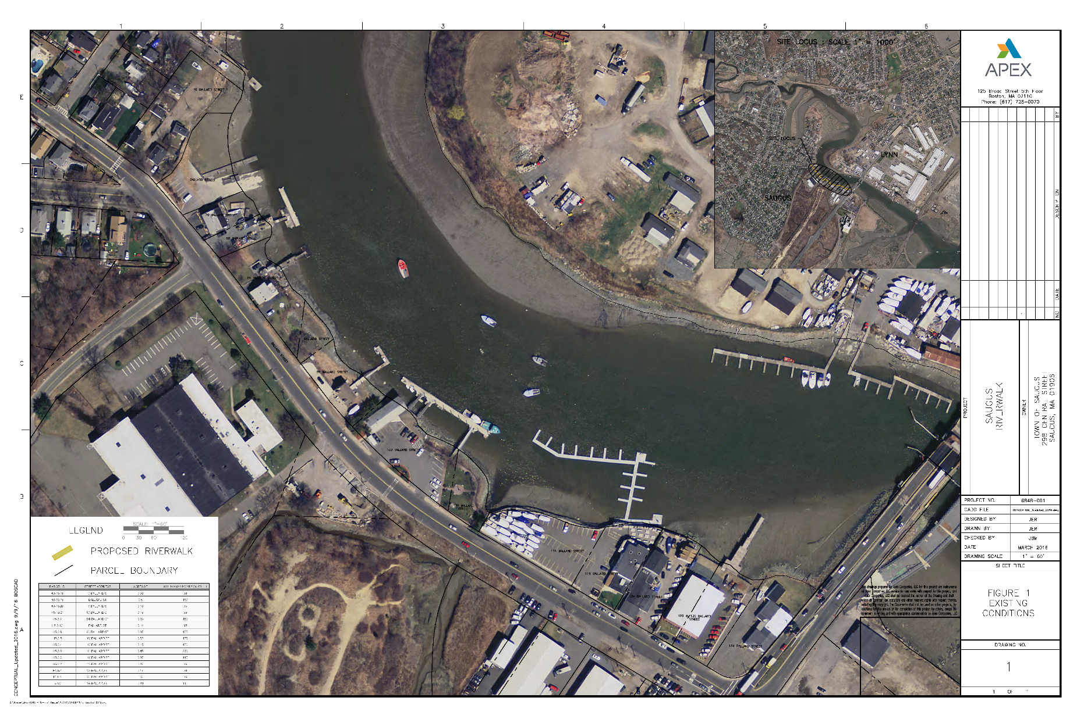
Project Area
The proposed RiverWalk extending from the State Route 107 Bridge to the vicinity of the public boat ramp on Ballard Street.
Wetland Resource Areas include:
- Riverfront Area
- Salt Marsh
- Land Subject to Coastal Storm Flowage (LSCSF)
- Land Containing Shellfish
- Bank
- Coastal Bank
- Land Under the Ocean
- 100-foot Buffer Zone
Notes:
Ballard Street runs along the southwestern bank of the Saugus River. The project area is adjacent to the Rumney Marsh Area of Critical Environmental Concern.

Slide 7
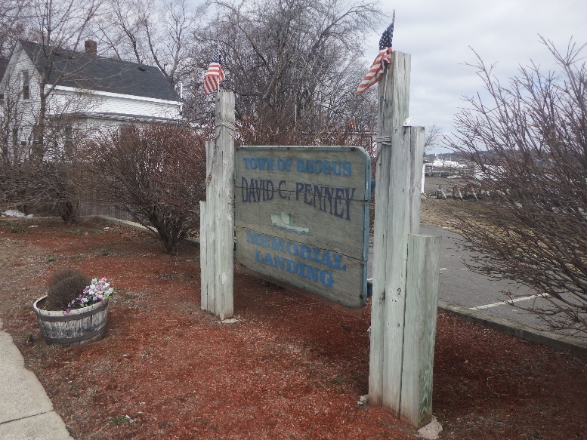
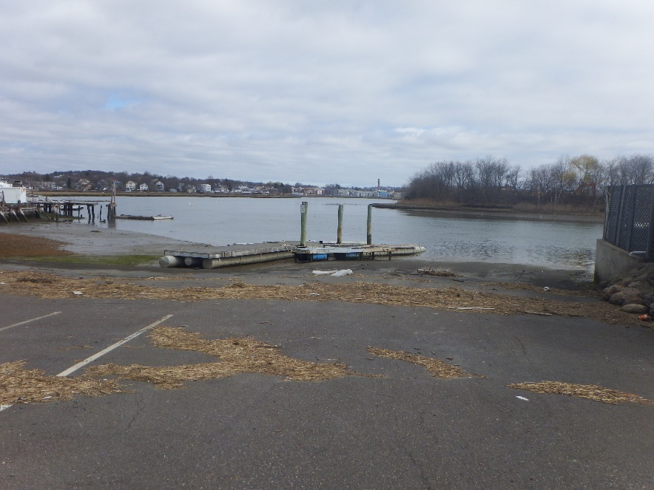
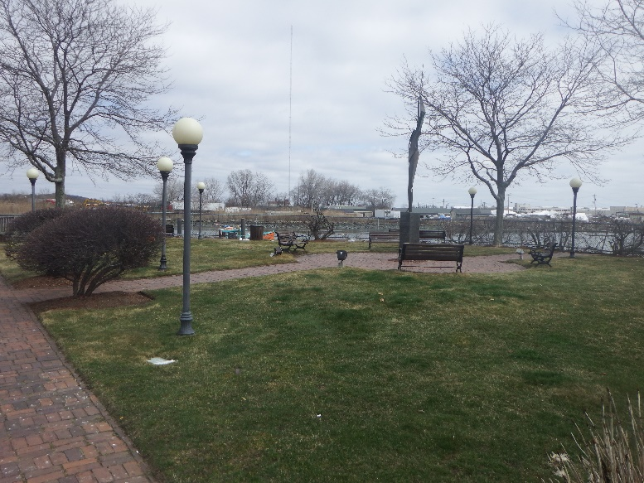
Locations for points of public access
There are currently two locations along the RiverWalk route that provide public access to the River’s edge:
  The Town Public landing at the northernmost edge of the Riverwalk
  Vitale Park, which is roughly midway of the proposed Riverwalk.

Slide 8
RiverWalk Alternatives Overview
The feasibility study looked at four different alternatives for the RiverWalk. The creation of the Saugus RiverWalk was judged as to its level of success by several key outcomes:
  The degree of greater public access to the river;
  The degree and quality of new private investment spurred on by the introduction of the RiverWalk in conjunction with the Waterfront Overlay;
  The growth in visitor/tourism traffic;
  The growth of hospitality related enterprises;
  Commercial and financial support of the Town’s core lobstering industry.
Notes:
In order to determine the optimal route layout for the RiverWalk, the study team looked at several different options and gauged those options against factors such as providing public access, permitting considerations, ease of design, project costs and integrating the RiverWalk into the community.

Slide 9
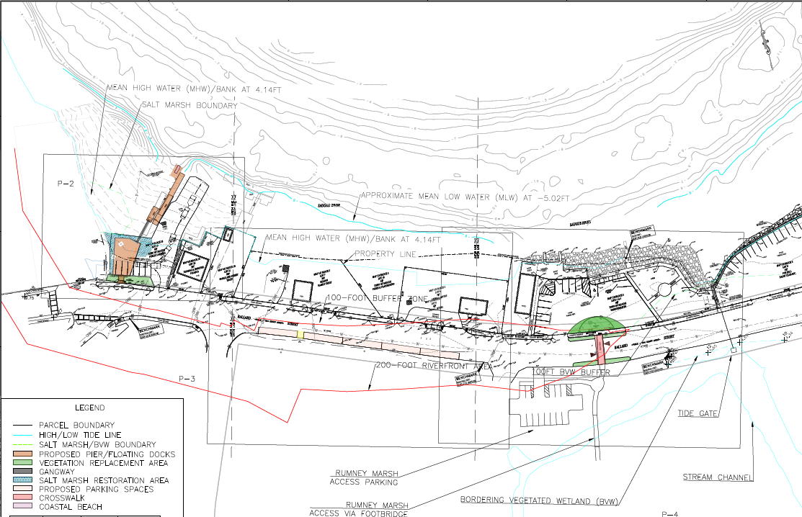
A RiverWalk Focused within the Town Right of Way and On Town Properties
This preferred alternative, would keep the RiverWalk entirely along the Town properties and within the Town Rights of Way
  Permitting: More Straightforward
  Design and Construction: Straightforward
  Community integration: Provides better access to the River by enhancing current features
Notes:
Permitting: This alternative presents a more straight forward permitting process. Access and ownership authorizations will be straightforward as all work will occur in municipally owned properties. The Town-owned properties already have well developed waterside infrastructure, so any improvements would not constitute a major change to the current use, therefore simplifying the permitting process.
Design and Construction: This alternative presents relatively straight forward design and construction challenges. The waterfront infrastructure on the Town-owned properties is pretty well developed and the sidewalks are relatively new in the rights of way, so the design upgrades aren’t as challenging as the other alternatives. From a construction standpoint, working near the water always presents challenges which are reflected in the costs, and there will still need to be some waterside work performed, particularly at the Town landing.
Maintenance requirements for this alternative would be more significant than what is currently performed, as there is an anticipated increase in use, and upgrades at the Town Landing and Vitale Park would require additional maintenance activities.
Community integration: Integrating the Riverwalk to the Surrounding Community under this alternative will only be of marginal improvement from the existing condition. Residents and visitors will have the same access points to the river, however that access would be improved upon as part of the upgrades of this alternative. This alternative does provide additional incentive to support the growth in visitor/tourism traffic and the growth of hospitality related enterprises, however only marginally so with the limited improvements. With respect to expanding and enhancing commercial and financial support of the Town’s core lobstering industry, there will be marginal improvement in generating more visitors at Vitale Park creating more interest in the lobstering activities occurring there and there is potential for that to generate new opportunities and revenue streams for the lobstering industry in the area. The economic expansion activities would have to be limited to the Town owned properties.

Slide 10
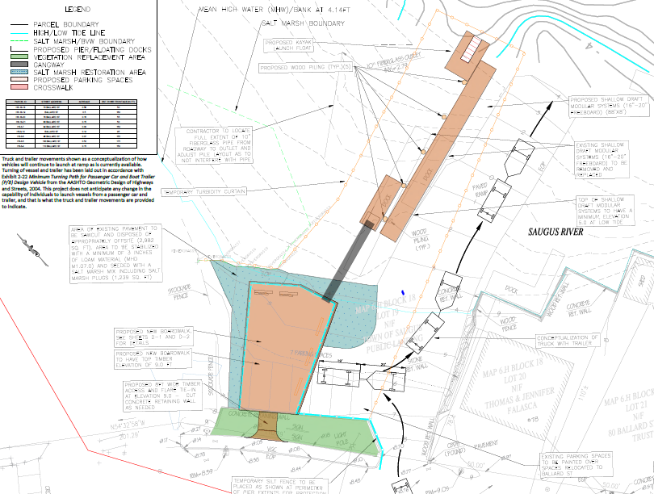
Proposed RiverWalk – The Boat Launch
Proposed Work:
Remove existing pavement (2,965 square feet)
Construct Pier (1,873 square feet)
Construct Dock Floats (690 square feet)
Remove existing timber piles and construct 5 12” timber piles to support dock float
Construct Kayak Launch (175 square feet)
Wetland Resource Areas present:
Bank (inland and coastal)
Land Under the Ocean (no impacts proposed)
Riverfront Area
Salt Marsh (no impacts proposed)
LSCSF
Land Containing Shellfish
Notes:
The main activities being presented as part of this filing for the Saugus RiverWalk project is to create the connection between the existing Vitale Park and Lobsterman’s Landing facility, the Rumney Marsh Restoration area (managed by the MA DCR) and the Town of Saugus’s Boat launch parcel. At the boat launch parcel, we are also proposing a new pile supported boardwalk with gangways, new timber piles and floats to improve access to the river and provide a kayak launch.
The proposed project includes removing 2,965 sf of paved impervious area and restoring it as a tidal marsh with native salt marsh plantings. There will be five (5) new 12” diameter timber piles driven to support the dock floats, including a kayak launch float at the edge. To support the new boardwalk/pier structure, there will be 42- 12” diameter timber piles driven to a depth of 40 feet. The boardwalk pier structure will also be constructed of timber and connect to the retaining wall off the north side of Ballard Street.

Slide 11
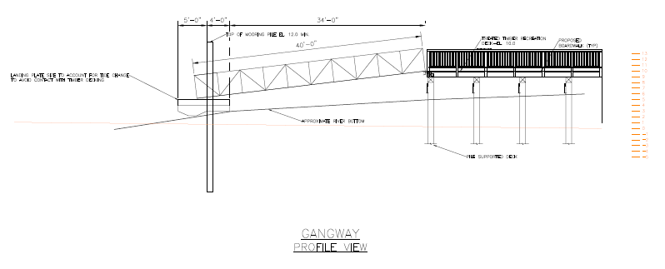
Proposed RiverWalk – The Boat Launch
Notes:
The main activities being presented as part of this filing for the Saugus RiverWalk project is to create the connection between the existing Vitale Park and Lobsterman’s Landing facility, the Rumney Marsh Restoration area (managed by the MA DCR) and the Town of Saugus’s Boat launch parcel. At the boat launch parcel, we are also proposing a new pile supported boardwalk with gangways, new timber piles and floats to improve access to the river and provide a kayak launch.
The proposed project includes removing 2,965 sf of paved impervious area and restoring it as a tidal marsh with native salt marsh plantings. There will be five (5) new 12” diameter timber piles driven to support the dock floats, including a kayak launch float at the edge. To support the new boardwalk/pier structure, there will be 42- 12” diameter timber piles driven to a depth of 40 feet. The boardwalk pier structure will also be constructed of timber and connect to the retaining wall off the north side of Ballard Street.

Slide 12
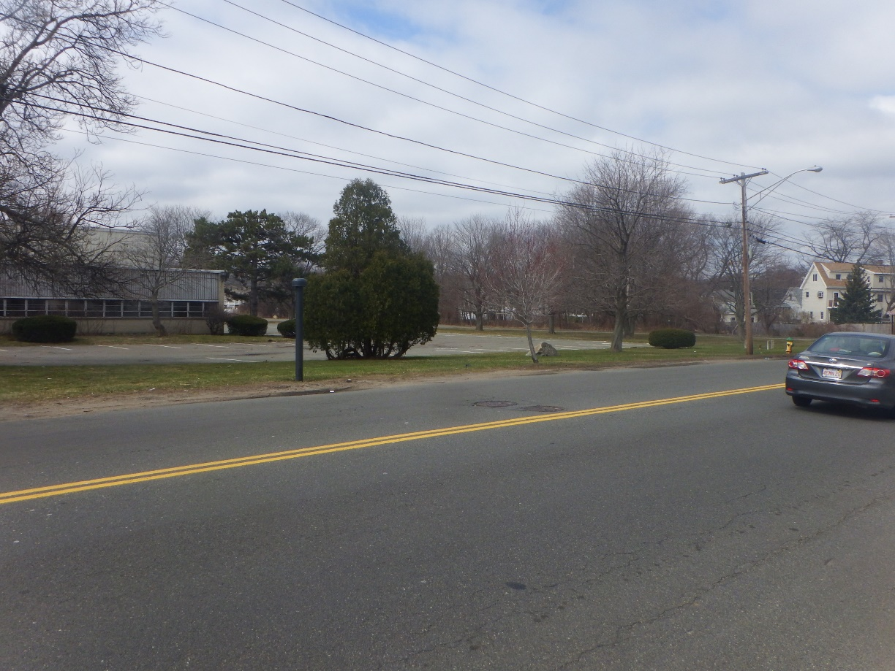
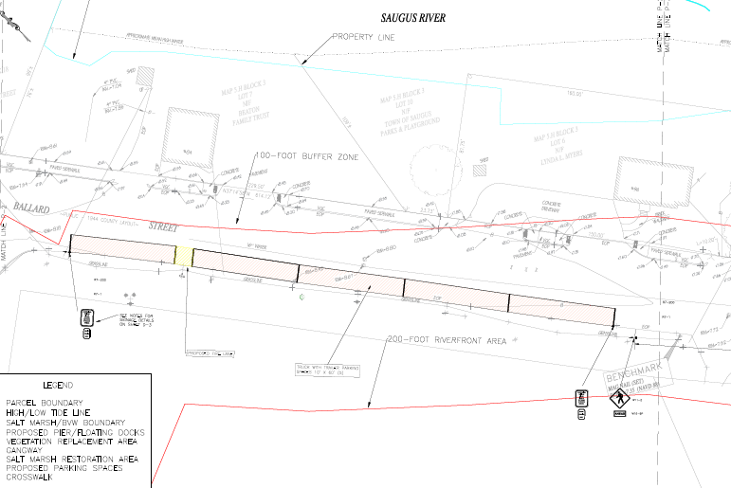
Proposed RiverWalk – Ballard Street
Proposed Work:
Create 5 parallel parking spaces within existing paved portion of Ballard Street
Wetland Resource Areas present and proposed work impacts:
Riverfront Area (all proposed work - temporary)
LSCSF (all proposed work - temporary)

Slide 13
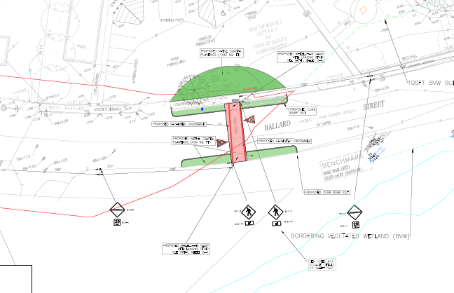
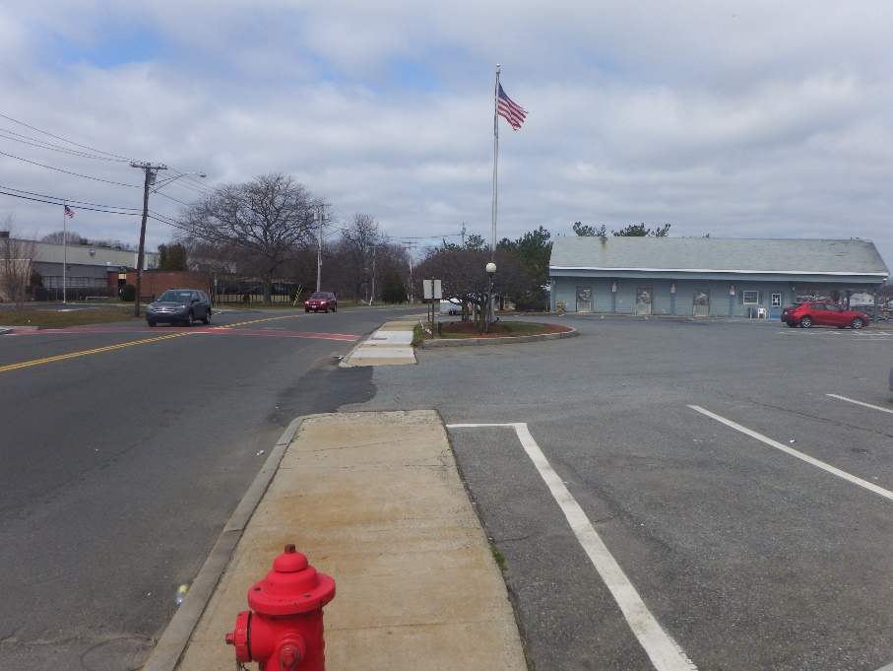
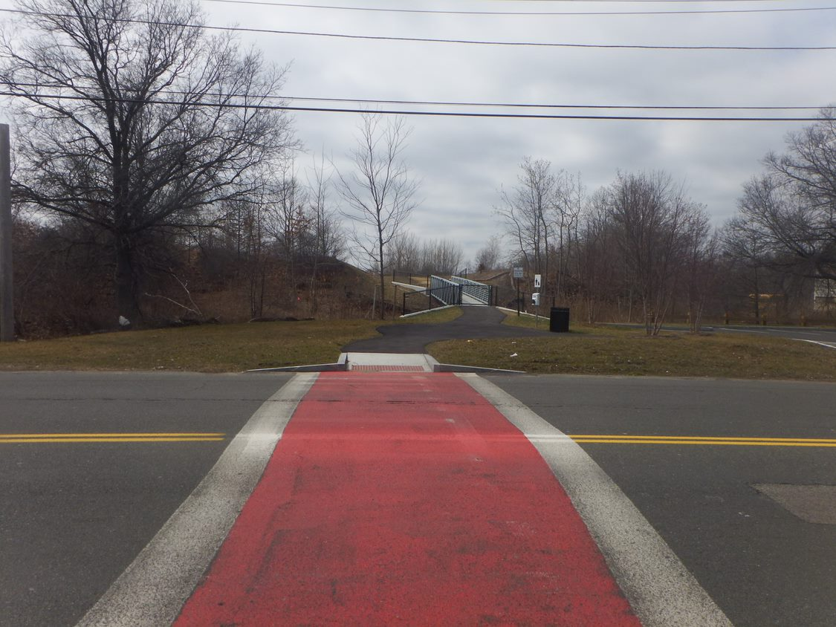
Proposed RiverWalk – Connection with the Rumney Marsh Area
Proposed Work:
Improve cross walk within paved and developed portions of Ballard Street and adjacent Town-owned parcels
Wetland Resource Areas present and proposed work impacts:
100-foot Buffer Zone (some proposed work - temporary)
Riverfront Area (all proposed work - temporary)
LSCSF (all proposed work - temporary)

Slide 14
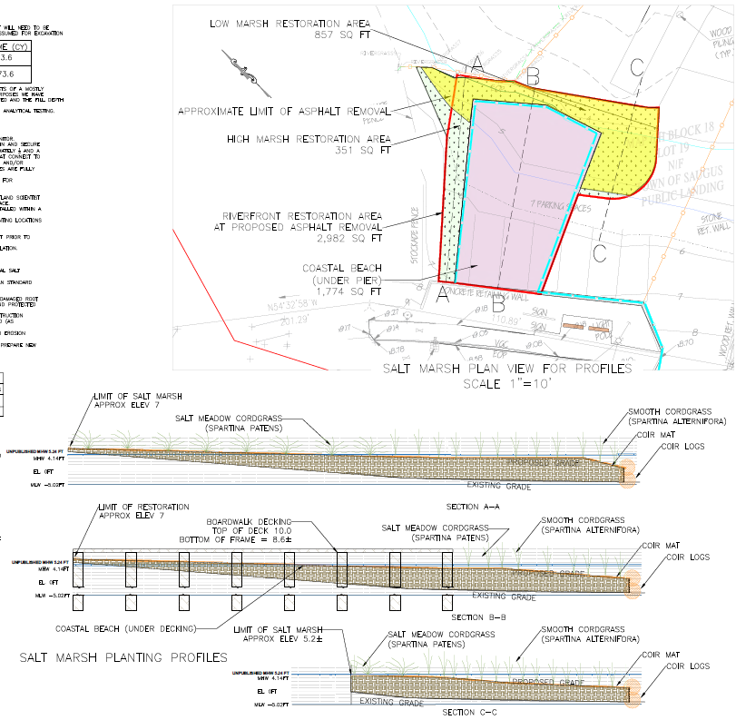
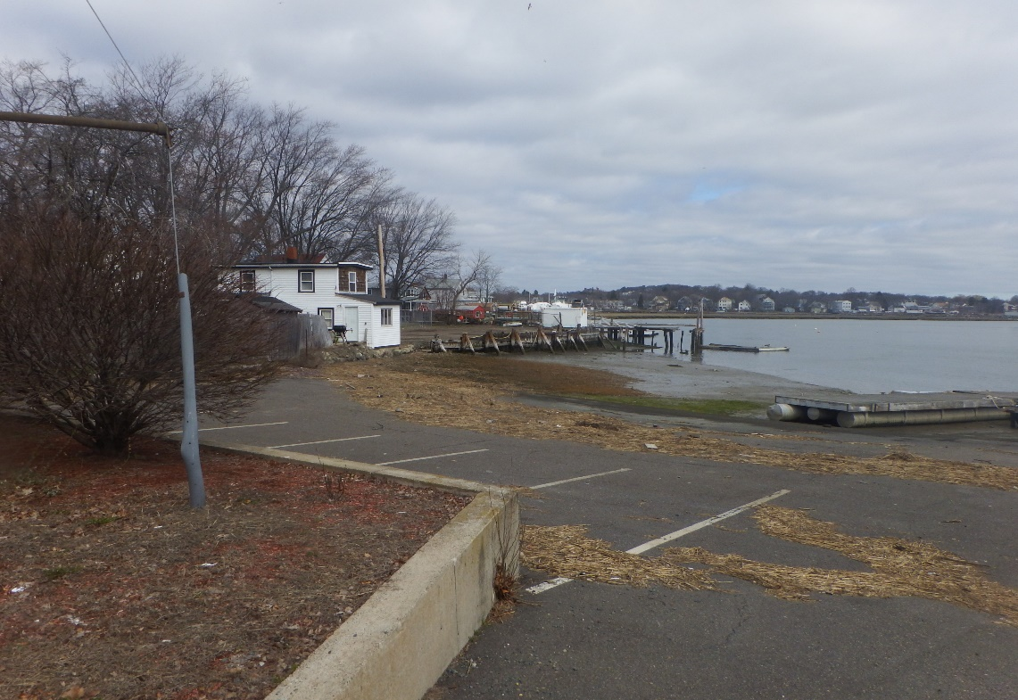
Proposed RiverWalk – Salt Marsh
Wetland Resource Areas present and proposed work impacts:
Bank (857 square feet of Low Marsh restoration area)
Riverfront Area (1,774 square feet restoration below proposed pier and 351 square feet of High Marsh restoration)
Salt Marsh (None)
LSCSF (Entire project footprint)
Shellfish Habitat (Portions of Project Footprint and Restoration area)

Slide 15
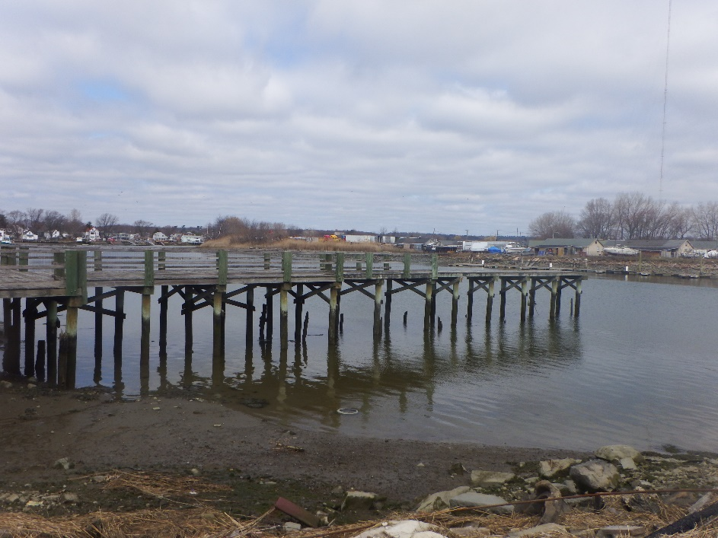
Environmental Impacts and Benefits
The Saugus River is an Outstanding Resource Water and part of the Rumney Marsh Area of Critical Environmental Concern
  Permitting through :
    MEPA (ENF) – Certificate Issued on July 24, 2020
    MA DEP – Chapter 91 and 401 WQC
    Saugus Conservation and MA DEP Wetlands Protection Act
    USACE 404 Permit
    The proposed project includes removing 2,965 sf of paved impervious area and restoring it with native salt marsh plantings (1,239 sf) and 1,774 sf of coastal beach resource area
    Promotes Public engagement and recreational opportunities which is a strong feature for an ACEC, to develop a bond to help the public want to protect the resource.
Notes:
There will be five (5) new 12” diameter timber piles driven to support the dock floats, including a kayak launch float at the edge. To support the new boardwalk/pier structure, there will be 42- 12” diameter timber piles driven to a depth of 40 feet (or refusal). The boardwalk pier structure will also be constructed of timber and connect to the retaining wall off the north side of Ballard Street. In total, the pier is proposed at 1,873 sf with 690 sf of new dock floats and a 175 sf kayak launch float.

Slide 16
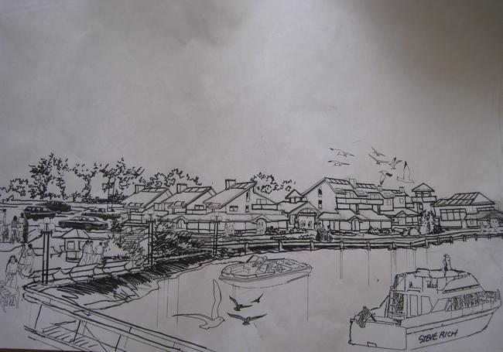
Benefits
Provides the community with a connection to the Saugus River Provides a connection to the neighborhood and businesses Better access to the Boat Launch, Vitale Park and the MA DCR’s Rumney Marsh Recreation project.
Integrates the RiverWalk into the surrounding community,
Creates better access to the River,
Creates potential for growth,
May support to the Lobstering Industry.
Notes:
The primary goal of the project is to enhance accessibility to the Saugus River waterfront. By making the necessary improvements the added benefits will include:
greater public access to the river;
the quality of new private investment spurred on by the introduction of the RiverWalk in conjunction with the Waterfront Overlay;
the growth in visitor/tourism traffic;
the growth of hospitality related enterprises;
commercial and financial support of the Town’s core lobstering industry.

Slide 17
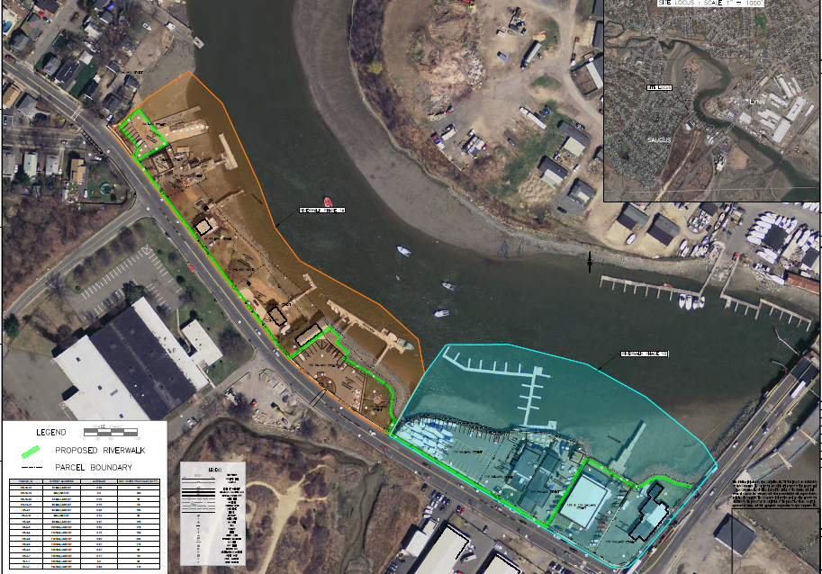
Potential Expansion
If funding can be identified, there is the potential for future phases of the project to include:
An extension to the Route 107 Bridge
An extension towards Lincoln Avenue
Connections with bike routes such as the Northern Strand
These expansions have not been designed or studied and are not proposed, but are being presented for the potential of this project in the future if more funding can be identified.

Slide 18
Thank you!
Questions ?
John B. McAllister, P.E.
Apex Companies, LLC
124 Watertown Street, Suite 3F
Watertown, MA 02472
617-936-9024
jmcallister@apexcos.com

