Slide 1
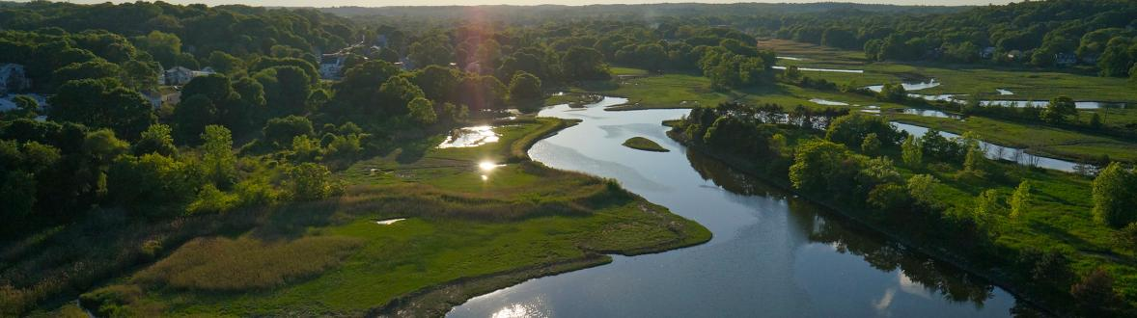


Virtual Visioning Workshop
September 15, 2020
SAUGUS UNITED 2035
Connecting our Past | Defining our Future
The Saugus Master Plan
Notes:
Welcome to first public event for Saugus United 2035, your town’s long range master plan
My name, title, who I’m joined with
Due to COVID-19 doing this remotely
Number of people registered for tonight’s event

Slide 2
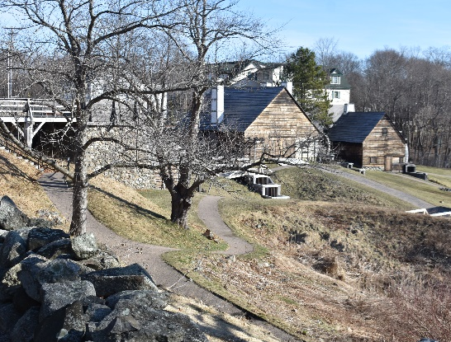
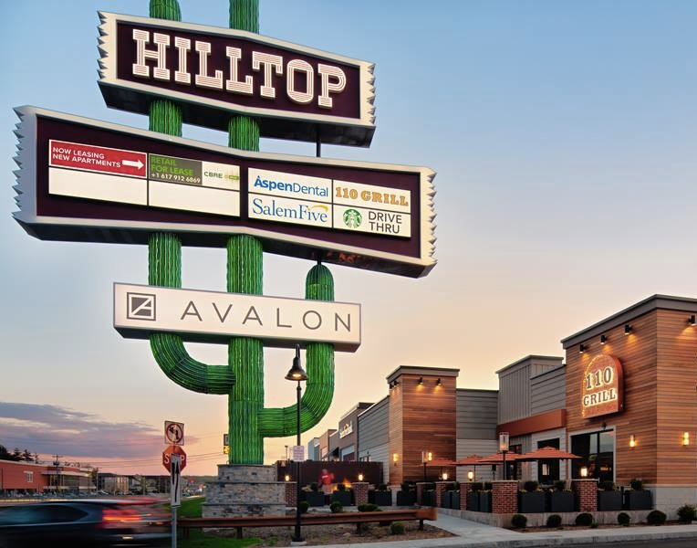
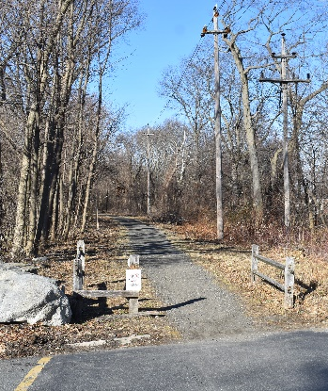
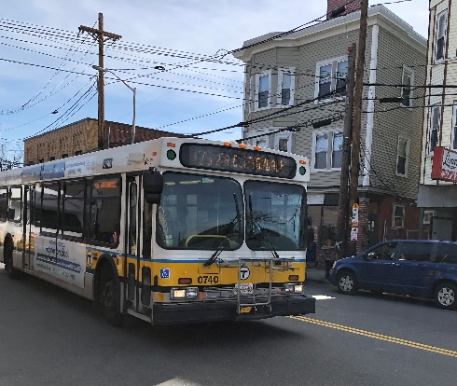
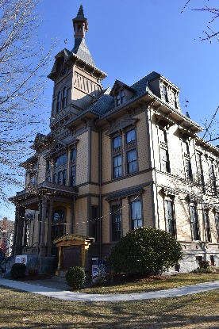
Saugus United: Connecting Our Past | Defining Our Future
Welcome + Introduction
  Welcome
  Scott Crabtree, Saugus Town Manager

Slide 3
Saugus United: Connecting Our Past | Defining Our Future
Agenda
  Welcome + Introduction
    Town Manager, MAPC, Advisory Committee
  Project Overview
    What is a Master Plan?
    How the Plan is organized
    Process + Timeline
  Community vision
    What is a “vision?”
    How is it formed?
  Setting the stage for the plan
    Information organized by topic
  Help shape the plan
    Q+A; Virtual “Open House”

Slide 4
Saugus United: Connecting Our Past | Defining Our Future
Welcome + Introduction
  Purpose of Tonight’s Meeting
  To welcome you and introduce you to the town-wide master plan process
  Invite your feedback on the initial crafting of a shared community vision
  Share information to stay engaged with the Saugus United 2035 process

Slide 5
Saugus United: Connecting Our Past | Defining Our Future
Welcome + Introduction
  MASTER PLAN ADVISORY COMMITTEE
  Scott Crabtree, Town Manager
  Chris Reilly, Director of Planning + Economic Development
  Alexander Mello, Senior Planner
  Jeanette Meredith, Admin. Aide
  Paul Rupp, Planning Consultant
  Anthony Cogliano, Selectmen Chair
  Ben Sturniolo, Board of Appeals Chair
  Peter Rossetti, Planning Board Chair
  David DeRuosi, Superintendent
  Joan Fowler, Conserv. Comm. Chair
  John Fralick, Public Health Director
  Frank McKinnon, Conservation Agent
  Laura Glynn, Housing Authority, Director
  Stephen Carlson, Historical Commission Chair
  Joanne Olsen, Saugus Senior Center
  Brendan O'Regan, DPW Director
  Michael Newbury, Fire Chief
  Michael Ricciardelli, Police Chief
  Todd Baldwin, Water/Sewer, Town Engineer
  Gregory Nickolas, Youth & Recreation Dir.
  Alan Thibeault, Library
  Mike Sullivan, Cultural Council
  Denise Selden, Chamber of Commerce
Notes:
A 25-member Master Plan Steering Committee has been appointed to advise the process. The Steering Committee includes representation from many of the Town’s Boards and Committees. That representation includes members from... The committee will be:
Providing input and guidance throughout the process and acting as plan ambassadors to assist in community engagement and communication of information.
Our work is being managed and coordinated by the Planning and Econ Dev Department with Chris Reilly and Alex Mello

Slide 6
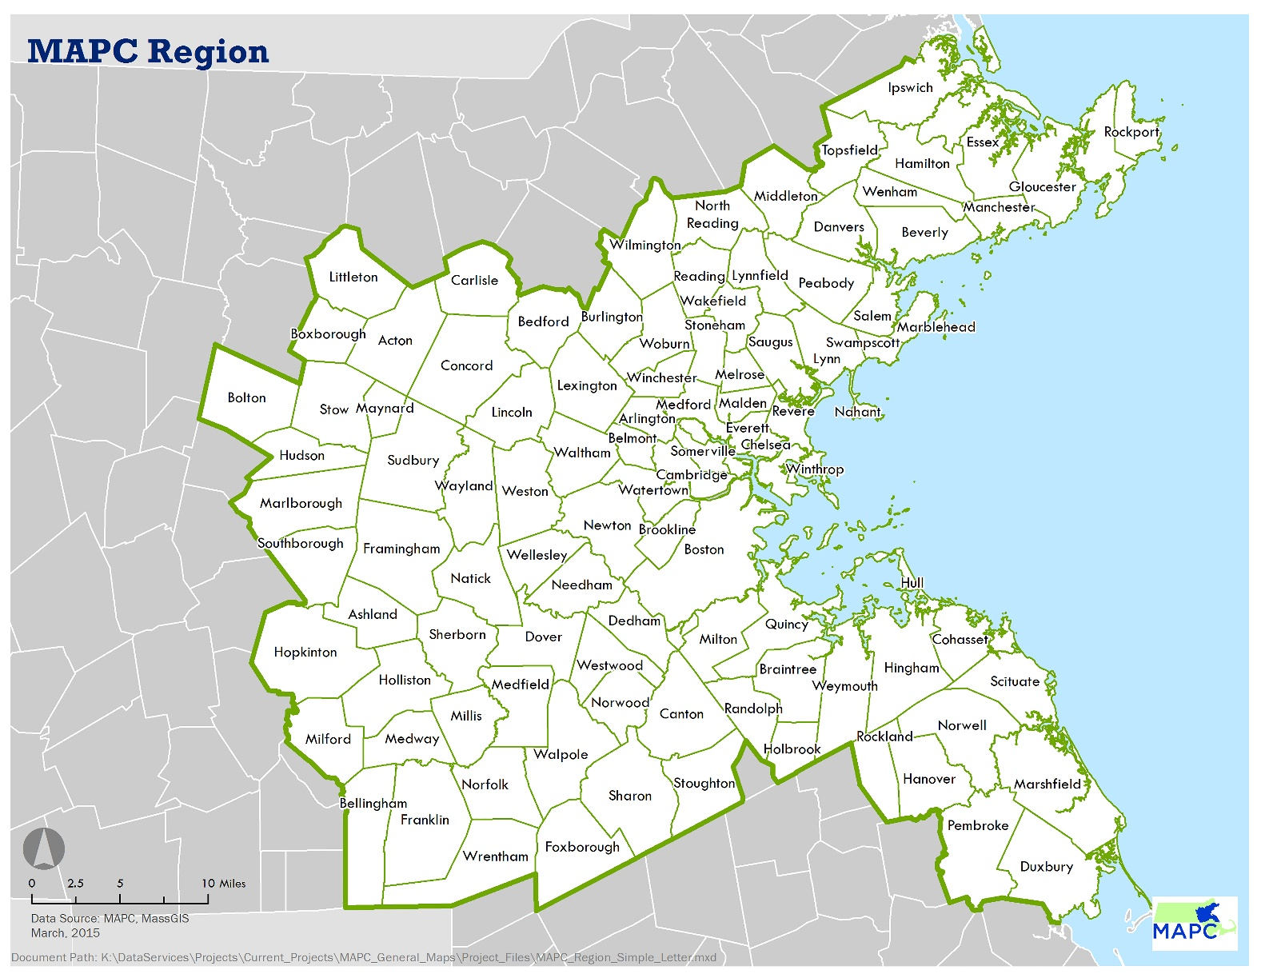
Saugus United: Connecting Our Past | Defining Our Future
Welcome + Introduction
  METROPOLITAN AREA PLANNING COUNCIL
Notes:
So now I’ll tell you a little bit about us. MAPC is the regional planning agency of the Boston Metropolitan area. We provide planning and technical assistance to the 101 cities and towns within the region, roughly the area within the Route 495 belt.
We wear a number of hats. In this case, we are acting as consultants to help facilitate creation of the plan. It’s not an MAPC vision for the future, it’s the Town’s vision. In other words, this project will result in a plan for the Town, by the Town. We are happy to be a part of this process. Our work is only as good as the feedback we receive from you all throughout this process so we will be focusing a lot of effort on providing meaningful opportunities for the community to engage with us.
We have a staff of about 100 at MAPC and have a great team assembled to support the Saugus Master Plan. Our staff have expertise across all the disciplines required of a master plan including Community Engagement, Land Use, Housing, Economic Development, Transportation, Arts and Culture, Municipal Collaboration, Data Services, Environment, Clean Energy, and Public Health.

Slide 7







Saugus United: Connecting Our Past | Defining Our Future
Welcome + Introduction
  Recent MAPC Master Plan Experience
Notes:
MAPC has recently completed master plan processes in ... Each plan is unique to the municipality with content that is defined by the community. This experience has provided us the framework, experience, and expertise to facilitate these processes in order to draw out the information that is needed and compose a plan that is meaningful and useful to the community.

Slide 8
Saugus United: Connecting Our Past | Defining Our Future
Project Overview
  What is a Master Plan?
It’s an opportunity to envision your future
  What do we want our town to be in 15 years?
It’s a process to set town-wide priorities
  What do we need to do to get there?
It’s an action strategy to achieve positive change
  How do we get started? What is next?
Notes:
It’s a document and a process

Slide 9
Saugus United: Connecting Our Past | Defining Our Future
Project Overview
  A Master Plan helps communities:
Manage growth and change
Provide for orderly and predictable development
Protect environmental resources
Set priorities for developing and maintaining infrastructure and public facilities
Strengthen local identity
Create a framework for future policy decisions
Promote open, democratic planning
Provide guidance to land-owners, developers, and permitting authorities
Notes:
Communities are changing. [Include quote from Lincoln about change]

Slide 10
Saugus United: Connecting Our Past | Defining Our Future
Project Overview
  HOW THE PLAN IS ORGANIZED
Saugus United 2035 has 3 components:
Baseline Report – snapshot of existing conditions
Roadmap – main policy document with vision and elements, organized by theme
Action Plan – how to implement the plan, who is responsible, and timeframes

Slide 11











Saugus United: Connecting Our Past | Defining Our Future
Project Overview
  HOW THE PLAN IS ORGANIZED
The Roadmap organizes the elements into themes
VISION
LIVE
Land Use + Neighborhoods
Vision + Goals
Housing
Facilities + Services
WORK
PLAY
CONNECT
Open Space + Recreation
Arts + Cultural Resources
Econ Development
Transportation
PROTECT
Energy, Sustainability + Resiliency
Historic + Cultural Preservation
Environmental Stewardship
Notes:
Roadmap is the heart of the master plan. Organized into themes around how we live in our communities. Begins with vision.

Slide 12
Saugus United: Connecting Our Past | Defining Our Future
Project Overview
2020
2021
SPRING
SUMMER
FALL
WINTER
SPRING
SUMMER
FALL
WINTER
M
A
M
J
J
A
S
O
N
D
J
F
M
A
M
J
J
A
S
O
N
D
J
F
Soft launch
Visioning
Setting goals
ENGAGEMENT
Plan Drafting
Plan Stewarding
Existing conditions
Vision + Goals
PLAN CONTENT
Full elements and support
Meetings:
Actions/Implementation
Notes:
The Master Plan process is still near its beginning, it is a 2-year process overall and began this past spring. The process involves starting at a high level with an overall vision and then breaking that vision down into more detail with goals in each of the topic areas of the master plan ultimately resulting in specific strategies and actions within a series of coordinated and interrelated topics that inform an implementation plan. The process will involve regular meetings of the Master Plan Steering Committee and a program of engagement opportunities that occur throughout the 2-years catering the events to the type of feedback that is needed at that moment in the process.

Slide 13
Saugus United: Connecting Our Past | Defining Our Future
Community Vision
The Vision describes a future for Saugus, achieved through the goals and recommendations of the Master Plan.
It is developed by the community, incorporating as many voices as possible.
It balances breadth with specificity
Notes:
Needs to be broad enough to encapsulate the town but also be meaningful. Saying high “quality of life” doesn’t mean much – everyone wants that but that might mean different things to different people.
So, we want to say what does high quality of life mean here? At the same time we don’t want it to be so specific that it alienates certain segments of the town? So, would probably want to avoid saying every resident should have a single family home with a big yard – we know a lot people aren’t able or don’t want to live (such as elderly) in that type of home, at least at all times of their life.
In this case, we might say something more about providing choices for where people live.

Slide 14











Saugus United: Connecting Our Past | Defining Our Future
Community Vision
Everything in Saugus United 2035 should ultimately trace back to the Vision
Notes:
After the town-wide vision, each of the various elements then has its own goals and strategies to help achieve the vision

Slide 15
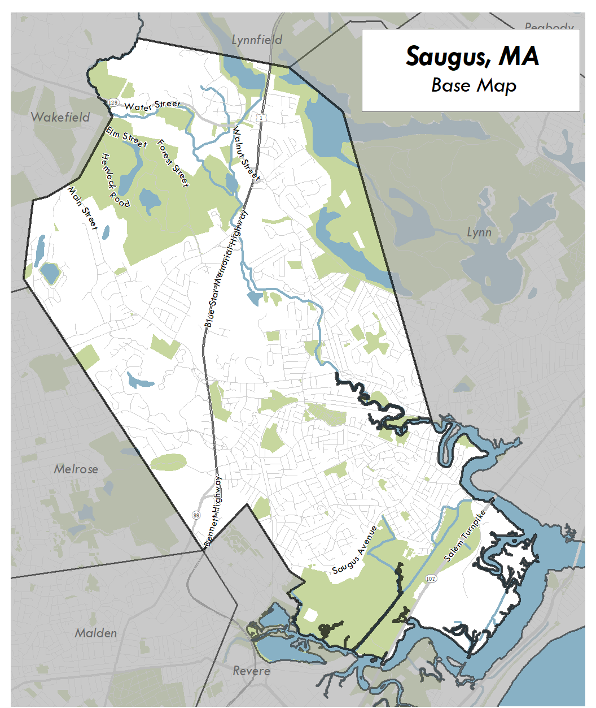
Saugus United: Connecting Our Past | Defining Our Future
Setting the Stage
Notes:
To help everyone understand where this process is headed, we wanted to take a few minutes to describe the variety of topics that will be addressed in the plan. This will help with defining the community vision, but also help you to focus where you may be most interested in offering us input and feedback. For each topic we will be using information from previous planning processes, analysis of current data, and your feedback to define goals, strategies, and actions that should occur over the next 10-15 years. We would like you to help us understand the most pressing challenges and opportunities within each topic.
The geographic context for the master plan is the full extent of the town, so we will be learning as much as we can about every corner of the town and addressing the rich variety of places that make up the town.

Slide 16
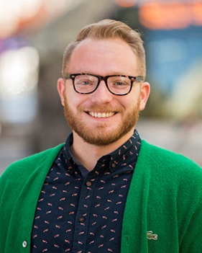
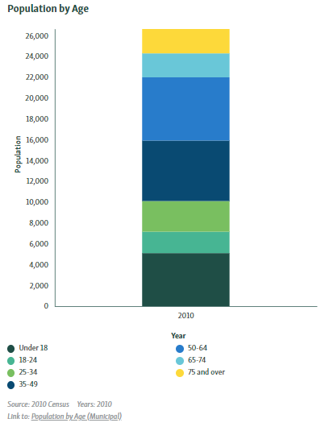
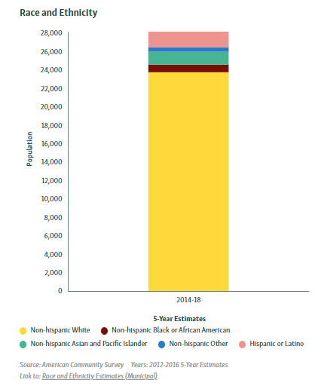
Saugus United: Connecting Our Past | Defining Our Future
Setting the Stage
Community Engagement
Christian Brandt, AICP
Community Engagement Coordinator
Notes:
One of the most important aspects of the community vision is that it is shared. In order to achieve this we need input from a broad range of community members and residents. In order to guide an inclusive and equitable process, our team has created a community engagement plan and is working with an advisory Committee and Planning Department to reach a broad audience. We have been analyzing the demographics of each neighborhood and learning about the social networks and connections with the Town to get word out about the plan and to get people engaged. We invite you to help us with that – tell your neighbor or social group about this process and refer them to the project website

Slide 17

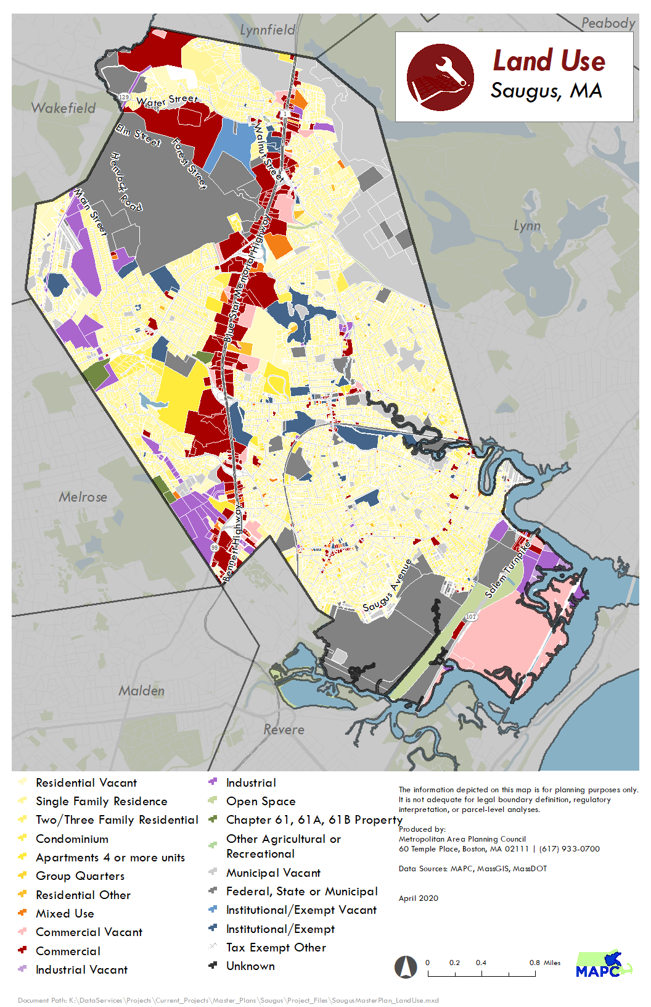
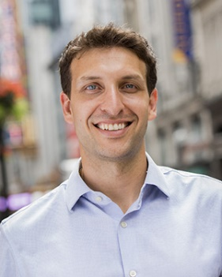
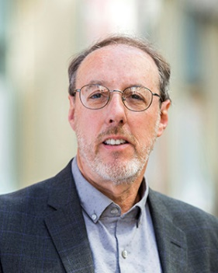
Saugus United: Connecting Our Past | Defining Our Future
Setting the Stage
Theme: Live
Element: Land Use
Chris Kuschel, AICP
Project Manager
Ralph Willmer, FAICP
Principal Planner,
Technical Assistance Program Manager
Notes:
Introduce briefly each topic. The maps are intended to show the type of existing conditions data we look at. When you go to the virtual open house, there will be more info on each of these topics.
Land Use is the first topic. The figure on the screen shows the variety of current uses in the Town. MAPC staff who will be focused on this topic are shown in the corner of the image, in this case myself and Ralph Willmer. The land use patterns are a reflection of the town’s history and evolution. Where do people live? Where do they shop? Work? Where do they recreate? But also, what is the character of those places?
Zoning is the regulatory framework that helps guide the future. The town is broken into various districts that allow certain uses, regulates how much parking is required, if there’s housing is a portion affordable, how much open space is required, if any, and dimensional standards (heights, etc.) The current zoning regulations will be evaluated for consistency with the community’s vision for the Town.

Slide 18

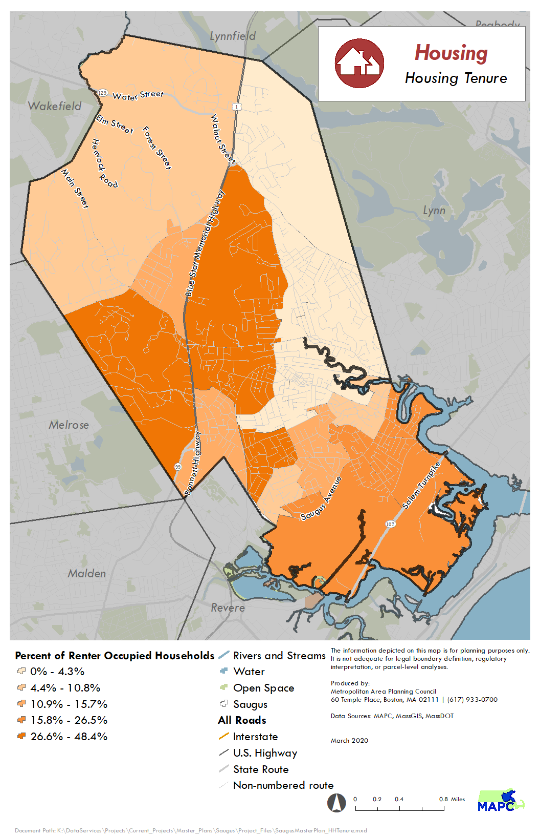
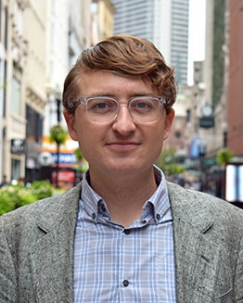
Saugus United: Connecting Our Past | Defining Our Future
Setting the Stage
Theme: Live
Element: Housing
John McCartin,
Regional Housing + Land Use Planner
Notes:
Housing is its own topic within the plan with John McCartin leading the effort for MAPC. Housing is always a hot button issue in communities, and I know that’s the case in Saugus, as well. On the one hand we want to ensure Saugus is an affordable community. On the other hand, we know that there are always concerns over impacts such as traffic and schools. We also know the town has a current housing moratorium, and so this master plan is an opportunity to coalesce around a vision and develop strategies to grow in a context-sensitive manner.

Slide 19

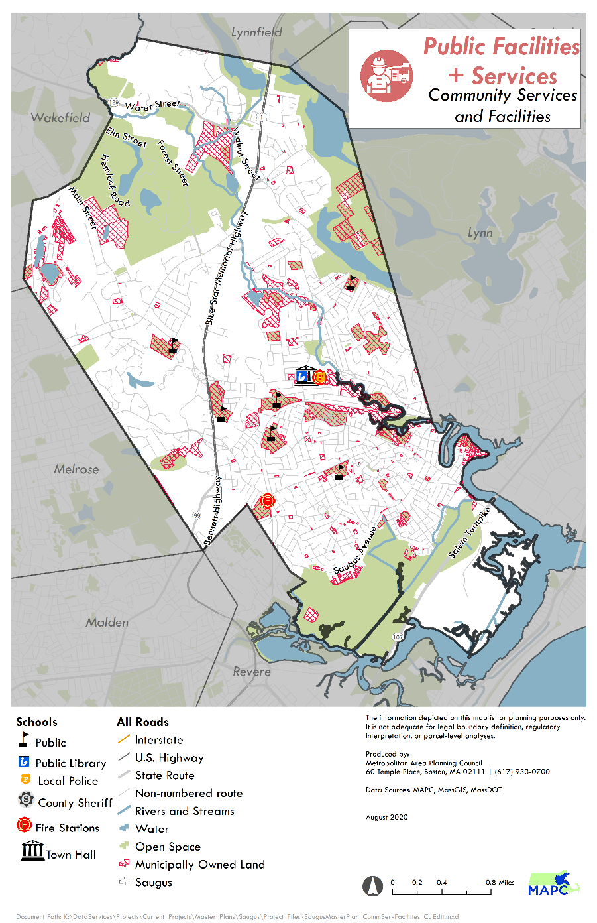
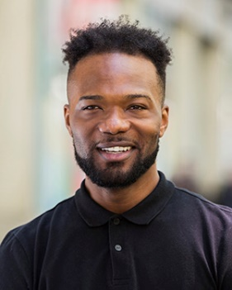
Saugus United: Connecting Our Past | Defining Our Future
Setting the Stage
Theme: Live
Element: Town Facilities + Services
Courtney Lewis
Regional Land Use Planner II
Notes:
Courtney Lewis is leading our town facilities and services element. And in fact Courtney is sort of our utility man who can really do it all, and as you’ll see is leading a number of elements. This elements focuses on strategies to ensure services and facilities are up-to-date and in locations that serve community best will be explored.

Slide 20

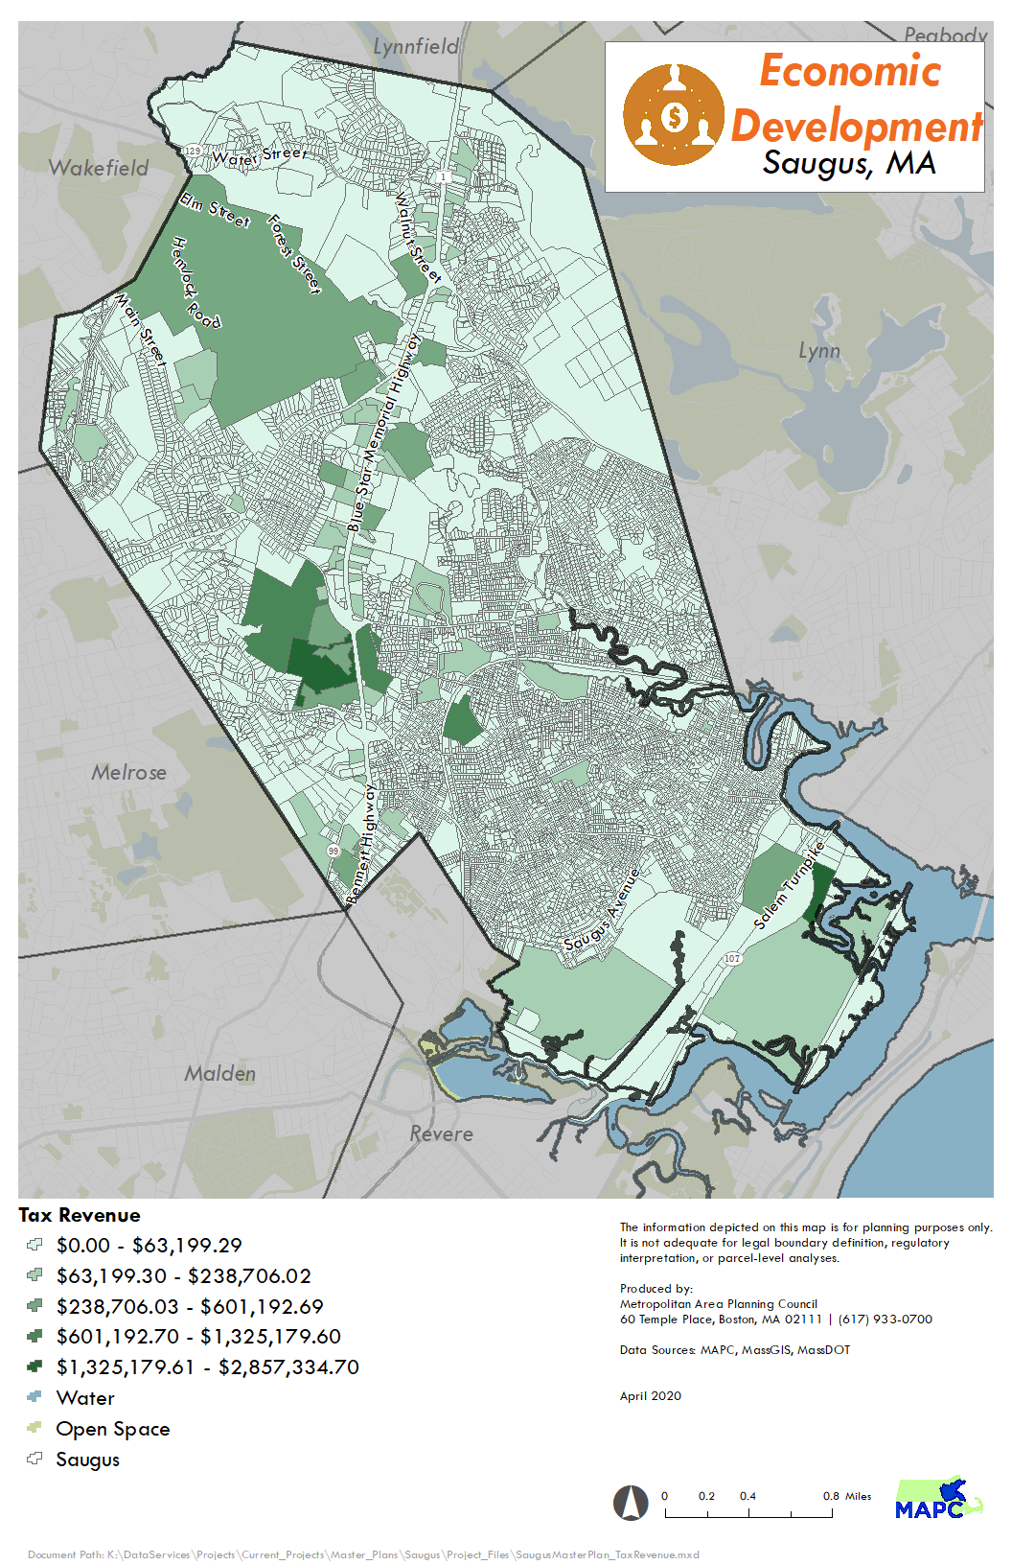
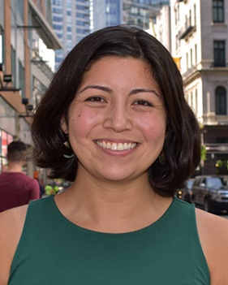
Saugus United: Connecting Our Past | Defining Our Future
Setting the Stage
Theme: Work
Element: Economic Development
Jenn Kaplan
Economic Development Planner I
Notes:
Economic development is being led by MAPC planners Jenn Kaplan. Includes an analysis of industry clusters, composition of the workforce, existing commercial centers, etc. MAPC will also review of various policies, local zoning, permitting regulations, and land use constraints as related to economic development.

Slide 21

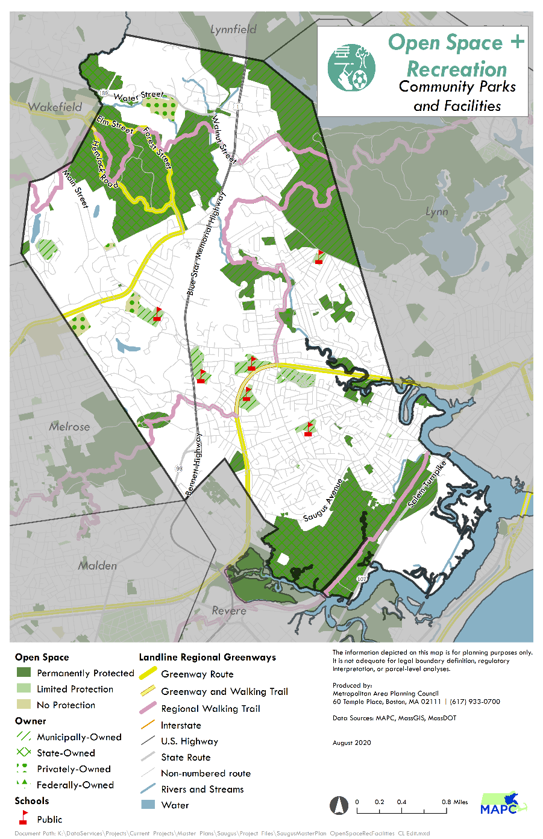
Saugus United: Connecting Our Past | Defining Our Future
Setting the Stage
Theme: Play
Element: Open Space + Recreation
Courtney Lewis
Regional Land Use Planner II
Notes:
Saugus’s new Open Space and Recreation Plan (OSRP) will serve as the basis for this element of the plan. The focus will be on how the town’s open space amenities are used and accessed.

Slide 22

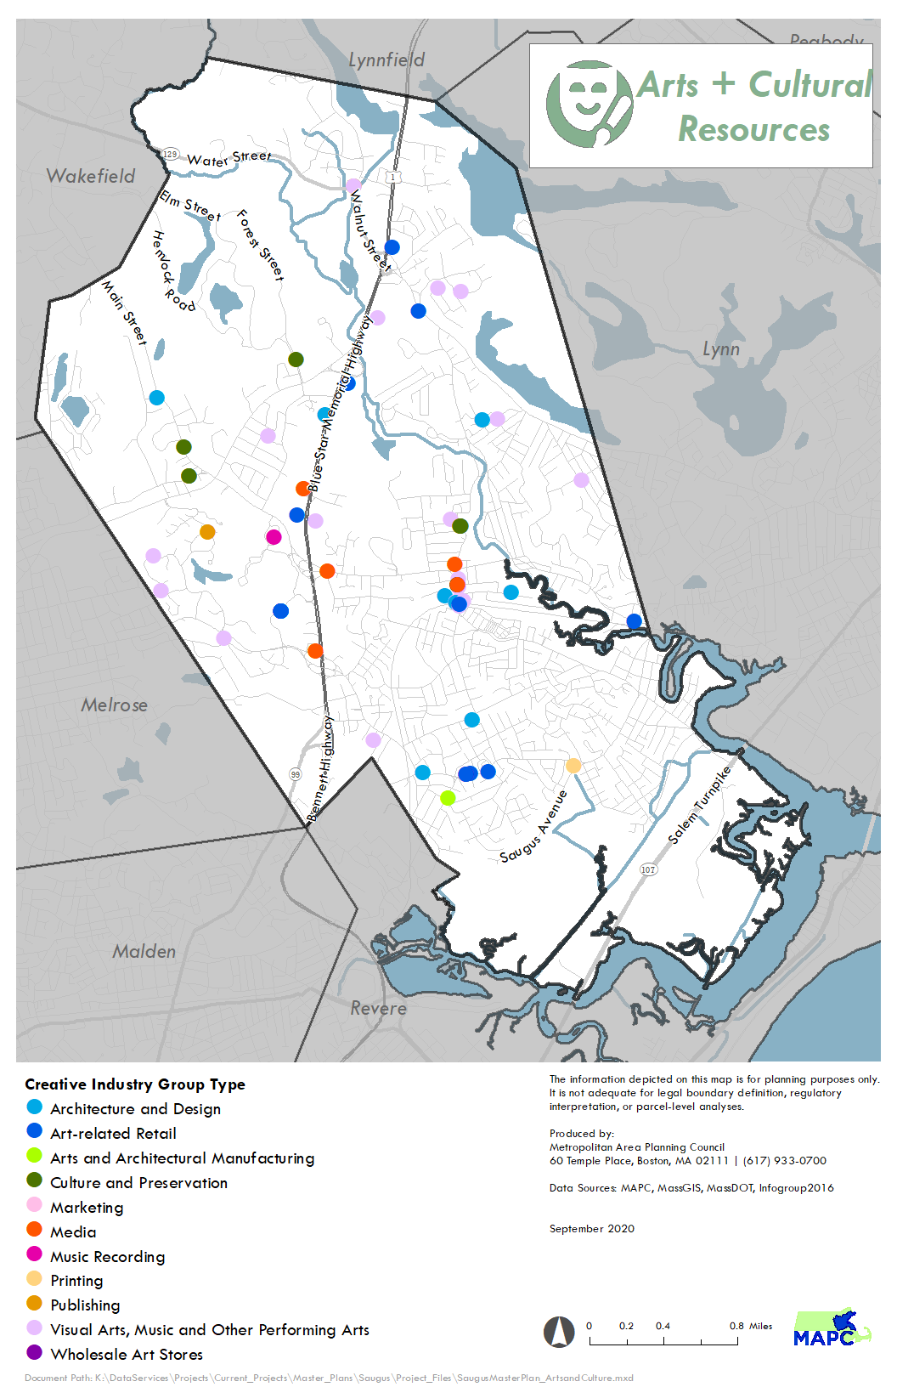
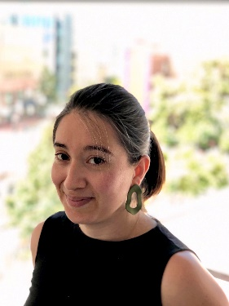
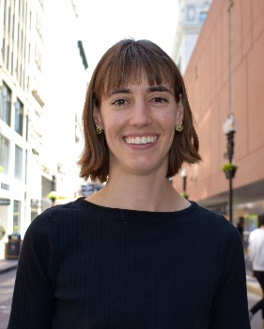
Saugus United: Connecting Our Past | Defining Our Future
Setting the Stage
Theme: Play
Element: Arts + Cultural Resources
Claudia Zarazua
Regional Arts + Culture Planner
Emma Boast
Arts + Culture Fellow
Notes:
Also within this theme of play is an examination of the town’s various arts + cultural resources. A vision and goals to further promote the creative industries and be an asset for the town.

Slide 23

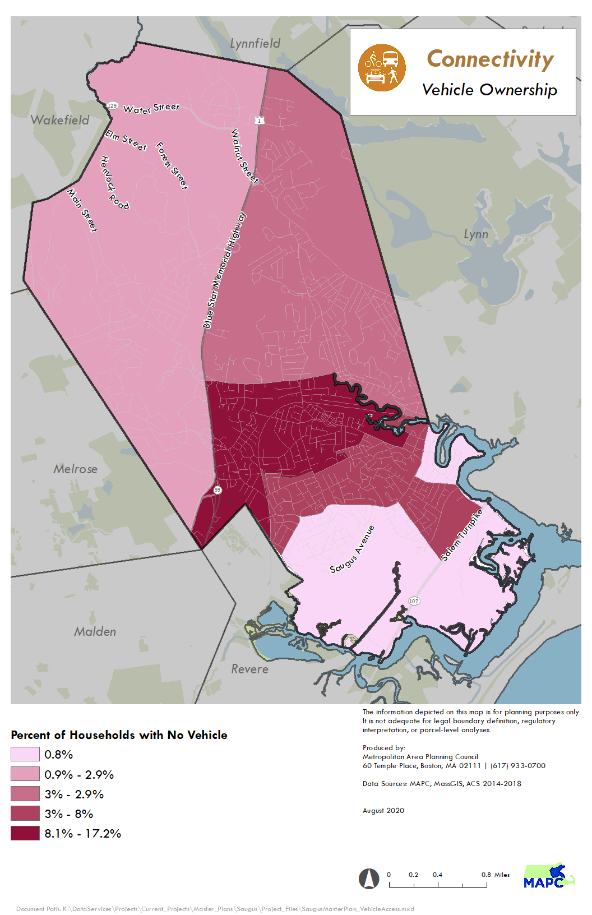
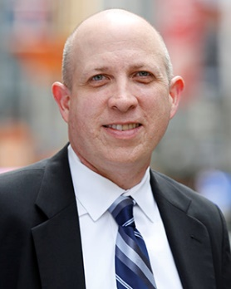
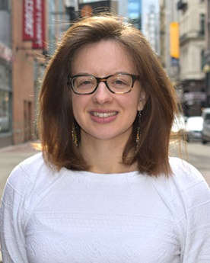
Saugus United: Connecting Our Past | Defining Our Future
Setting the Stage
Theme: Connect
Element: Transportation
Travis Pollack, AICP
Senior Transportation Planner
Marah Holland
Transportation Planner II
Notes:
Transportation is being led by MAPC’s Travis Pollack and Marah Holland. Saugus’ transportation infrastructure defines patterns of use and access in the Town. How we get around is incredibly important to people’s quality of life, no matter how it’s defined. MAPC will formulate a series of goals, strategies and actions to effectively create a more efficient multimodal transportation network that addresses auto, public and private bus service, bike and pedestrian needs.

Slide 24

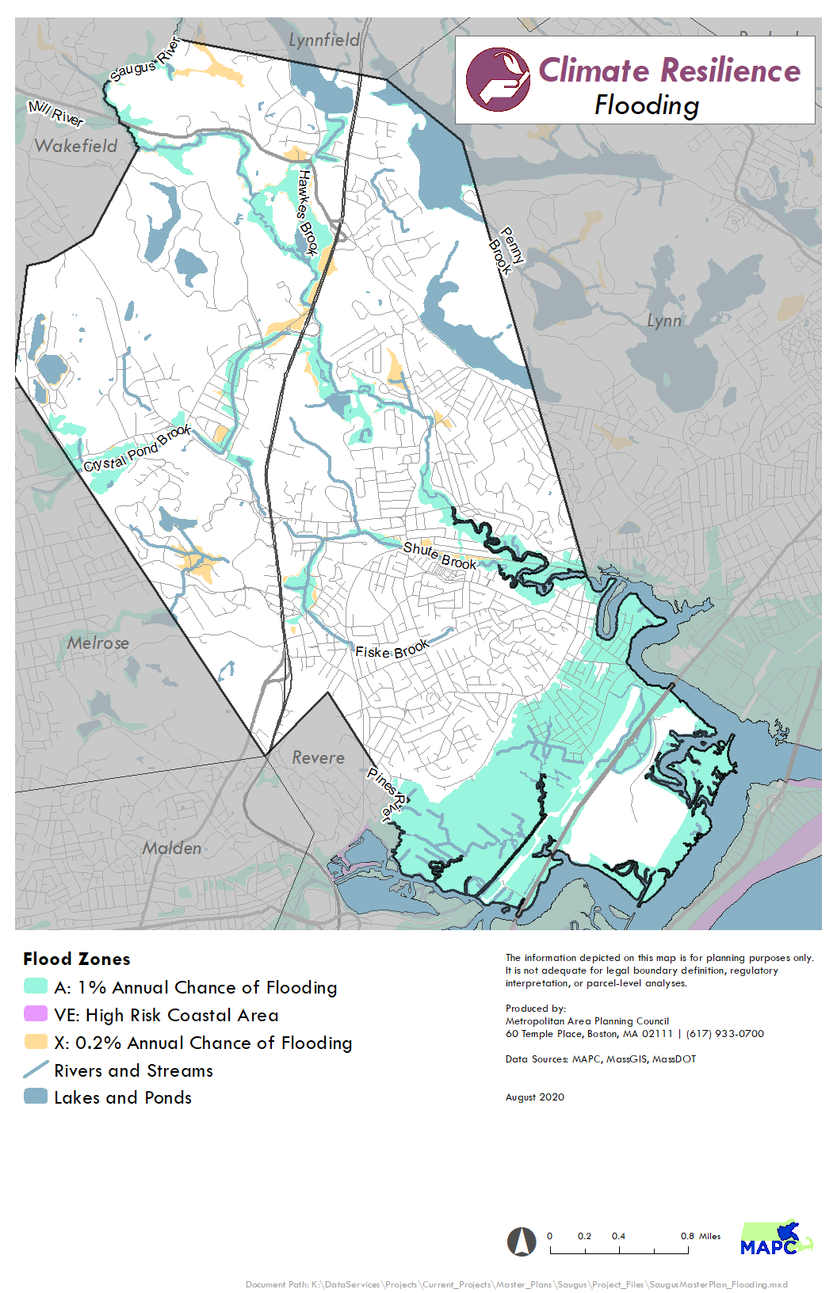
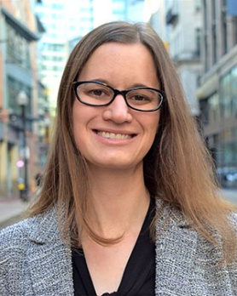
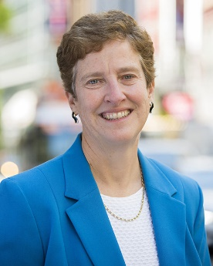
Saugus United: Connecting Our Past | Defining Our Future
Setting the Stage
Theme: Protect
Element: Energy, Sustainability, + Resiliency
Julie Curti
Senior Clean Energy + Climate Planner
Anne Herbst
Senior Regional Environmental Planner
Notes:
Protect theme –
This element of the Master Plan will address ways to reduce demand and greenhouse gas emissions through increased efficiency, green technologies, construction standards, etc. MAPC has additional funding through the Barr Foundation to fully integrate Climate Resilience in the Master Plan process. This element will incorporate the ongoing work done through the Municipal Vulnerability Plan and Hazard Mitigation Plan effort.

Slide 25


Saugus United: Connecting Our Past | Defining Our Future
Setting the Stage
Theme: Protect
Element: Historic + Cultural Preservation
Claudia Zarazua
Regional Arts + Culture Planner
Emma Boast
Arts + Culture Fellow
Notes:
Cultural and Historic Resources is tied closely to the Historic + Cultural Resources element in the Play theme. Slightly different focus on preservation of assets.

Slide 26

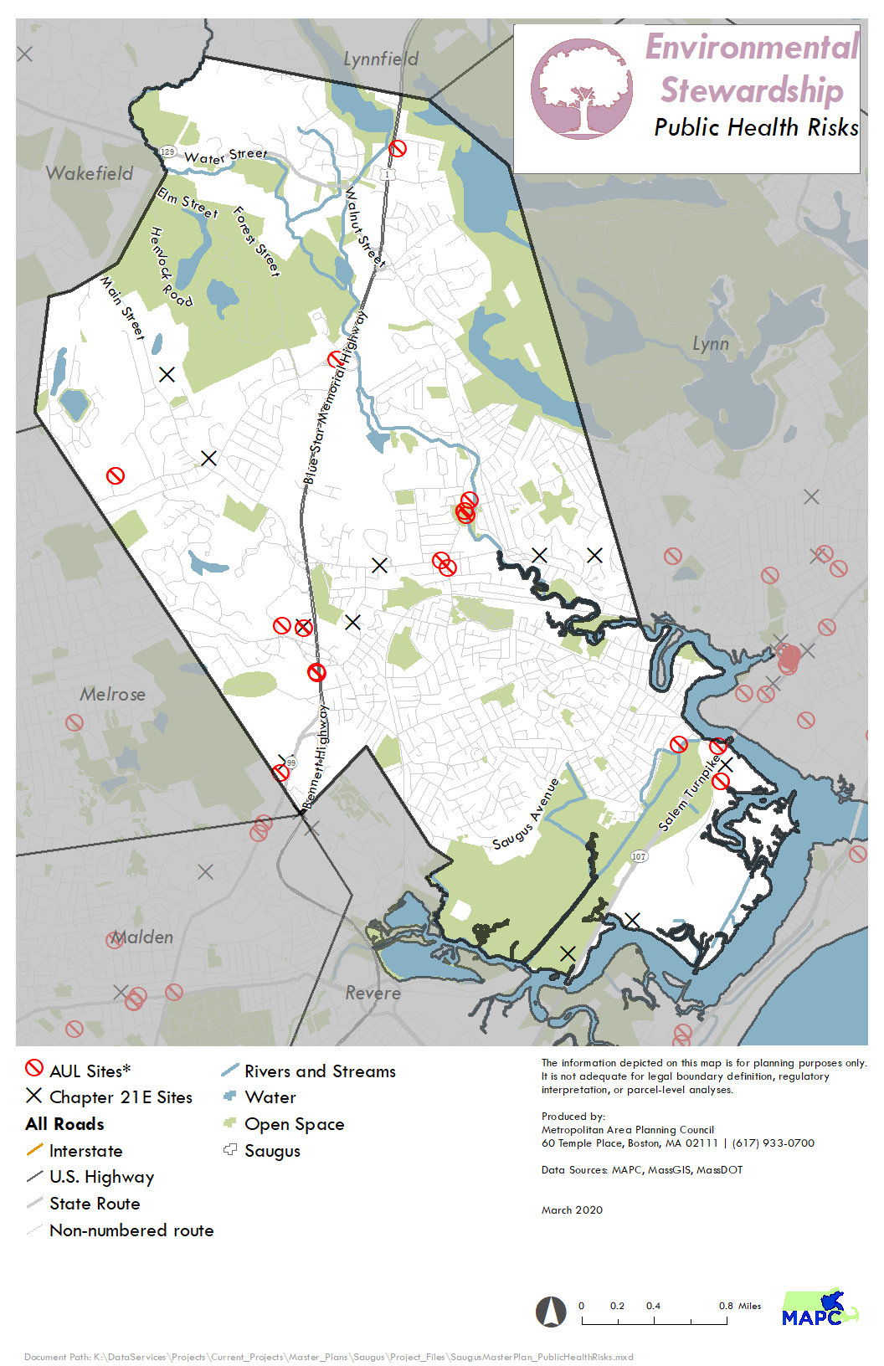
Saugus United: Connecting Our Past | Defining Our Future
Setting the Stage
Theme: Protect
Element: Environmental Stewardship
Courtney Lewis
Regional Land Use Planner II
Notes:
Similarly, environmental stewardship is tied closely to open space and recreation, but has more of a protection focus.

Slide 27
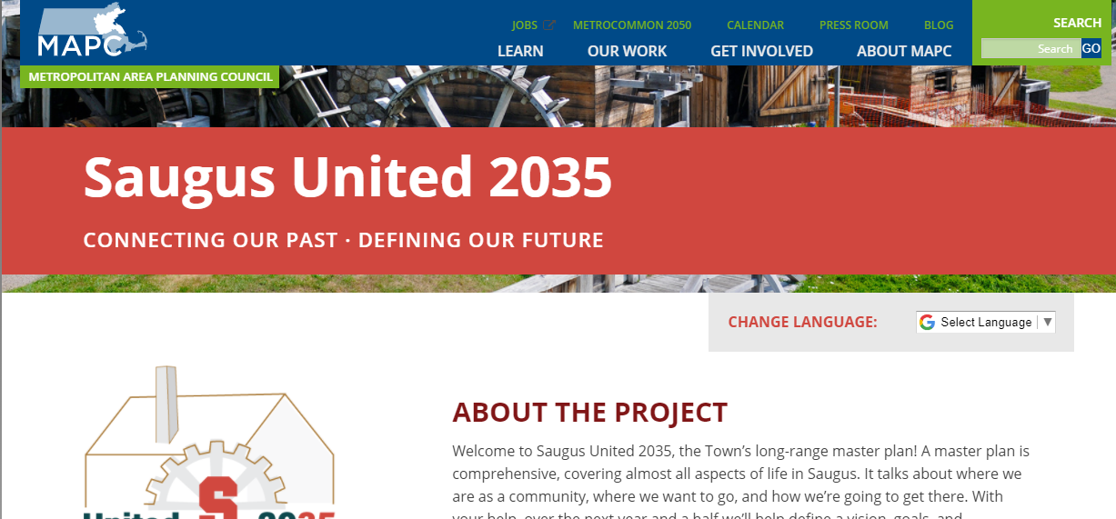
Saugus United: Connecting Our Past | Defining Our Future
Help Shape the Plan
  Ways to continue being involved:
  Visit the project website: www.saugusunited2035.org
  Join our mailing list. (Sign up on the website)
  Email Chris Kuschel directly with any comments. ckuschel@mapc.org
Notes:
This is the first step and we want people to remain involved throughout the process.

Slide 28
Saugus United: Connecting Our Past | Defining Our Future
Help Shape the Plan
  Input for the Vision:
  Tonight: Comments, Questions and Answers
  Participate in the Virtual Open House. Learn more baseline information and provide your thoughts on a variety of topics.
    http://mapc.ma/visioningopenhouse
    The Virtual Open House will be live from tonight through Friday, October 4.
Notes:
We would typically follow an introductory presentation such as this with a less formal open house where our team could talk with you and learn more about the town from your perspective. Unfortunately, we’ll have to save that type of event for another time.

Slide 29
Saugus United: Connecting Our Past | Defining Our Future
Question and Answer
  Two ways to ask a question:
  Raise your hand
  Click the “Raise Hand” button on the bottom of your zoom window (see image below).
  We will promote you to a panelist so you can ask your question.
  Questions will be answered in the order they are received.
  Post a Question in the Q&A
  Click on the Q&A Button and type your question into the text box. We will answer it directly in the Q&A or live.

