Slide 1
Saugus New Middle High School
Scott Crabtree- Town Manager
David DeRuosi – Superintendent of Schools
Michael Hashem- High School Principal
Jeannie Meredith – School Committee Chairperson
Kevin Nigro, OPM- PMA Project Manager
Joseph DeSantis, OPM – PMA Assistant Project Manager
Lori Cowles, AIA LEED AP—HMFH Project Director
Tina Stanislaski, AIA LEED AP—HMFH Project Manager

Slide 2
Project Update Master Plan/District Structure
Current District Structure
1 Pre-school
4 Elementary Schools K-5
1 Middle School 6-8
1 High School 9-12
Future District Structure
1 Lower Elementary PK- 2
Veterans Memorial School
1 Upper Elementary 3-5
Belmonte School
1 Middle/High School 6-12

Slide 3
Project Update District Structure/Educational Plan
Key Points:
Educational Equity for all schools-Performing Art Spaces, Art Classrooms, Science Labs, Libraries, Cafeterias, Gymnasiums, Special Education support space
Support the development and build the capacity for small learning communities in our schools
Align and strengthen current curriculum being delivered in the district
Strengthen vertical teaming
Design learning spaces that support student centered learning
Move from lecture based instruction model to student interactive model with project-based, hands-on learning
Support an inclusionary approach to special education
Allow for special needs students to be placed and move with cohorts of their peers

Slide 4
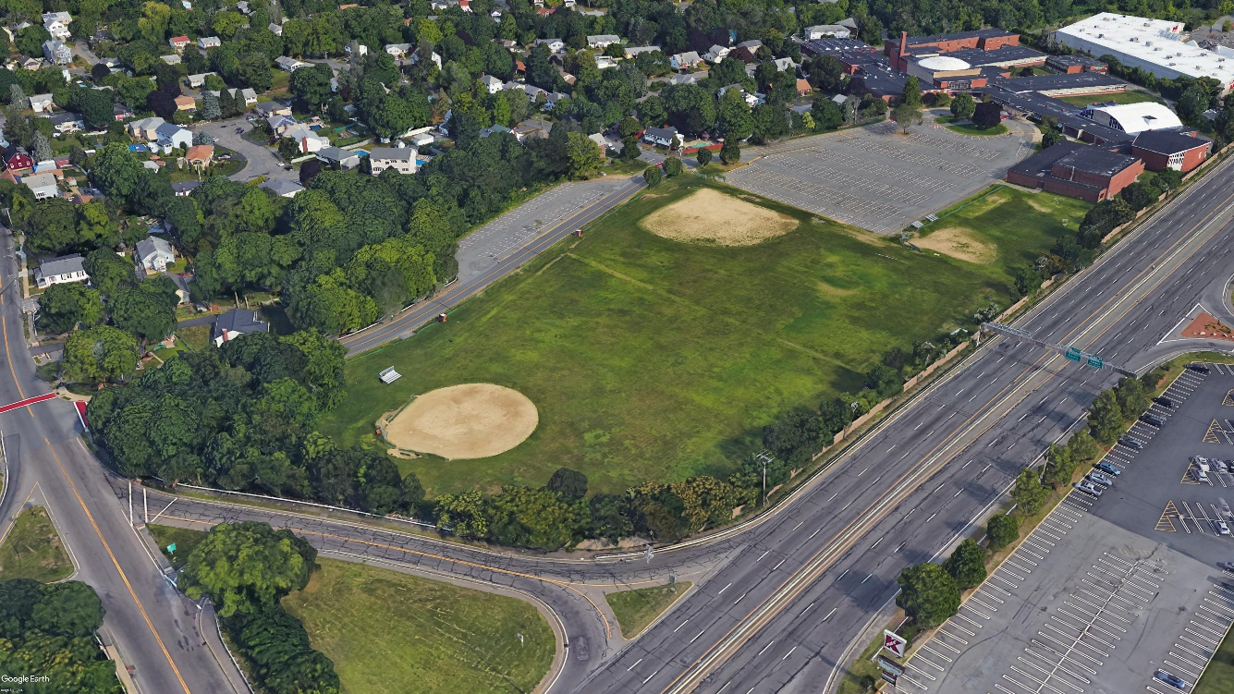
Project Update Site selection
Golf Course
Not owned by town
Wetlands
Species of Conservation concern
Not buildable property
Curley Property
Ledge
Wetlands
Species of Conservation concern
Not buildable
Current Saugus High School Site- Preferred Site
Town owned
Suitable size
Buildable property

Slide 5
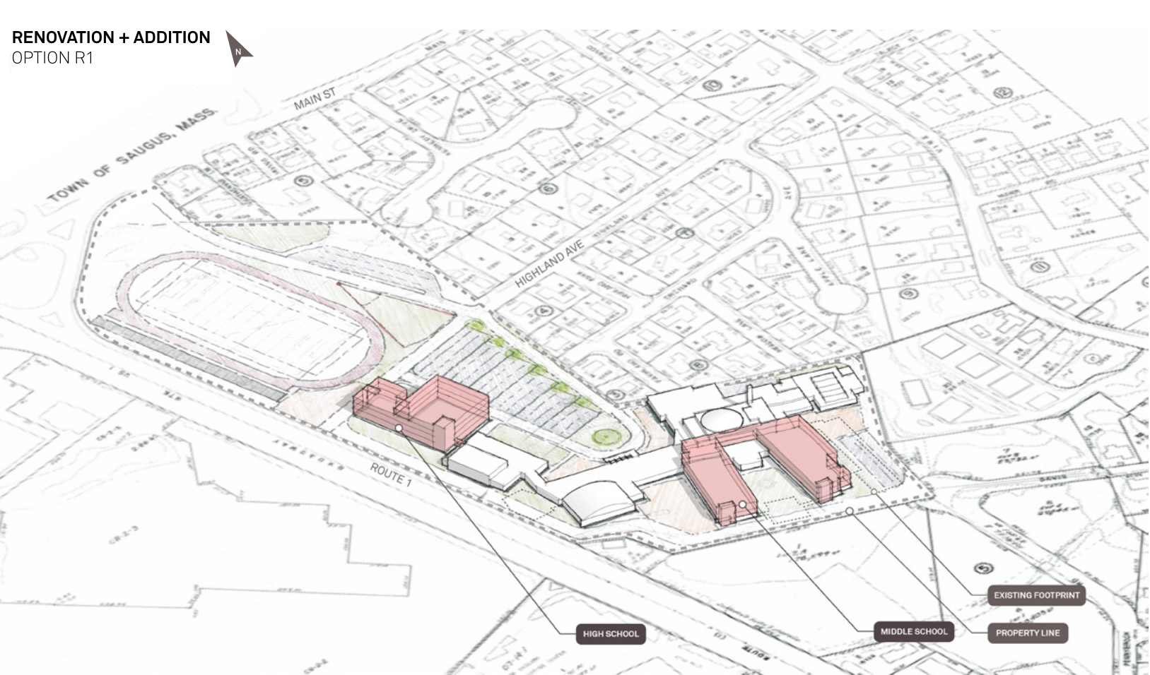
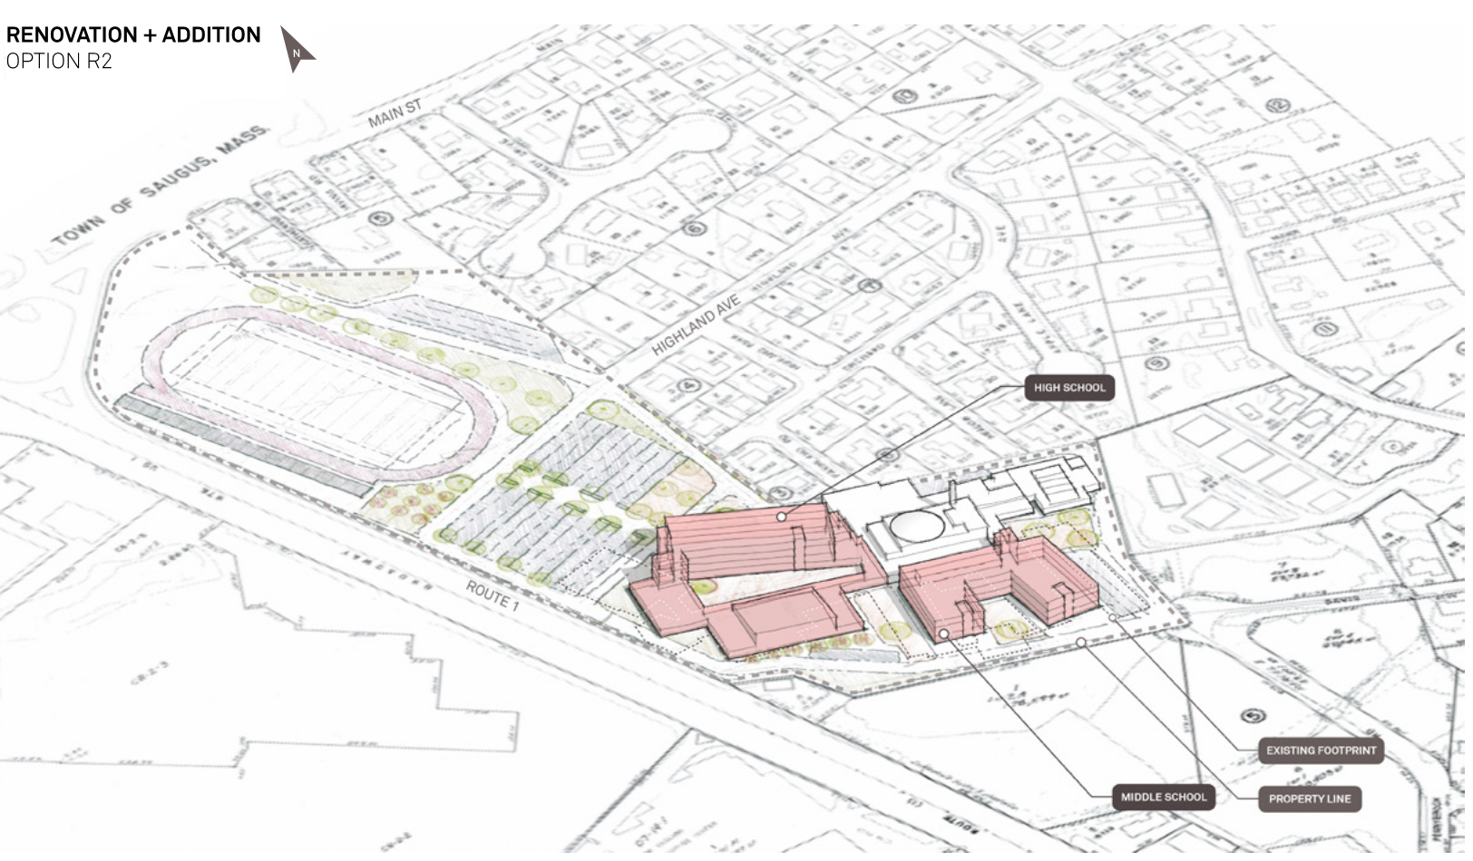
Project Update Options Studied during FS- Middle High School
Middle High School-Renovation addition options
R1
R2
Middle High School-Renovation Addition options are not preferred by the District because they require occupied, phased renovation, create a more congested site, have a higher construction cost and are most disruptive to education.

Slide 6
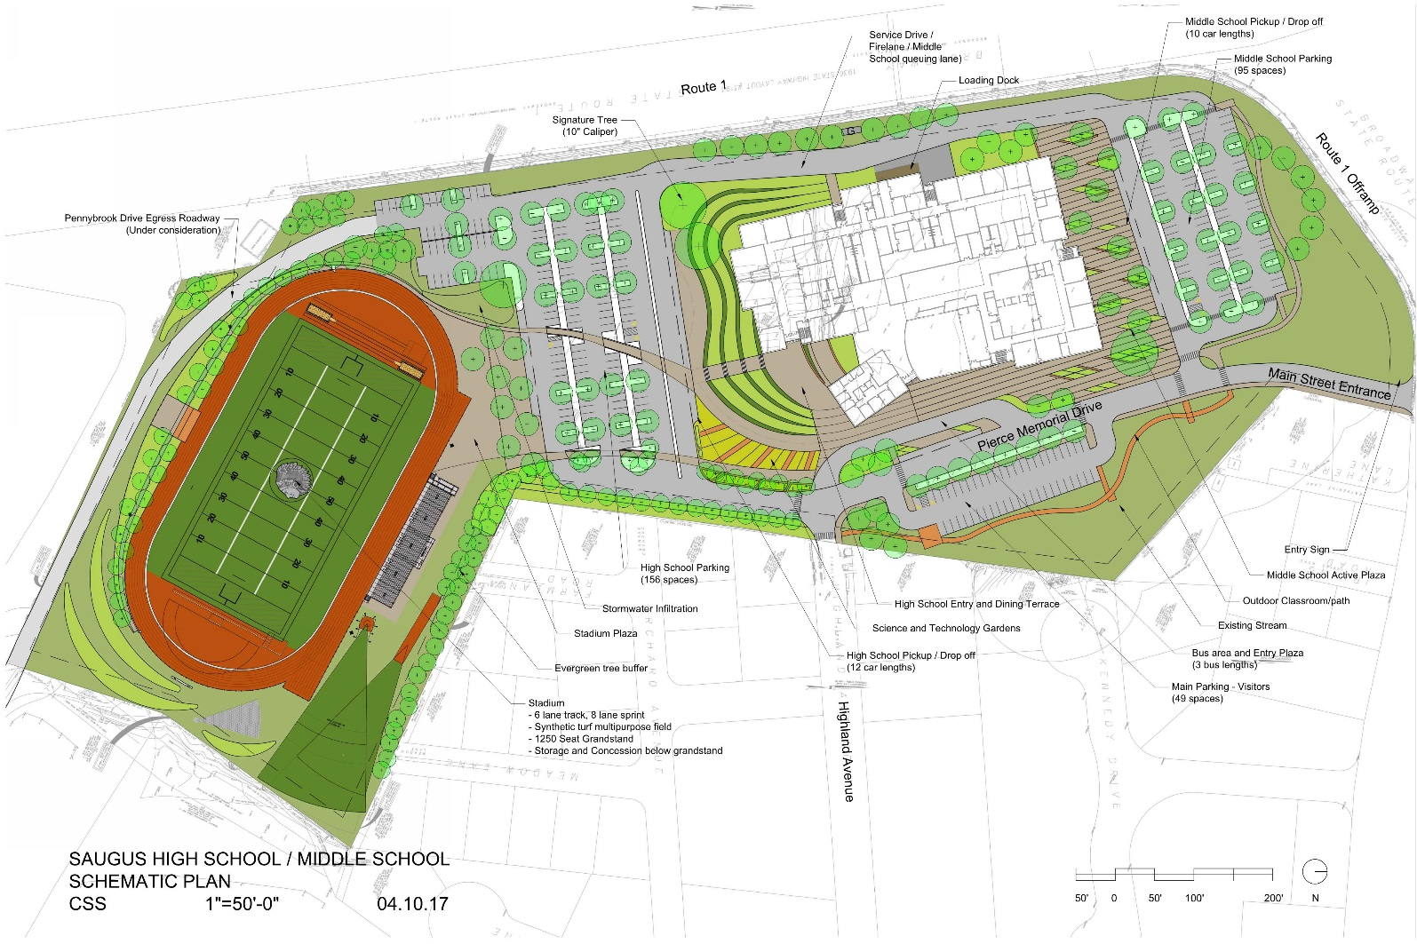
Project Update Site Plan
Route 1
North

Slide 7
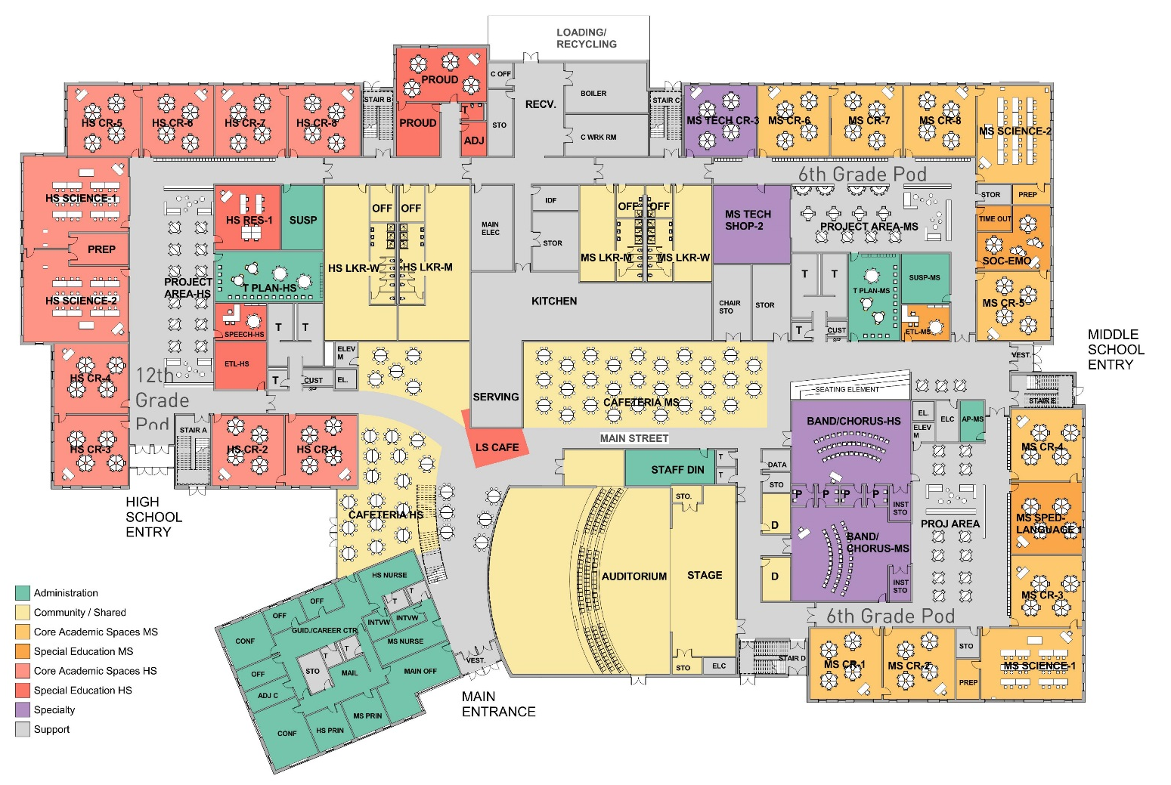
Project Update First Floor Plan

Slide 8
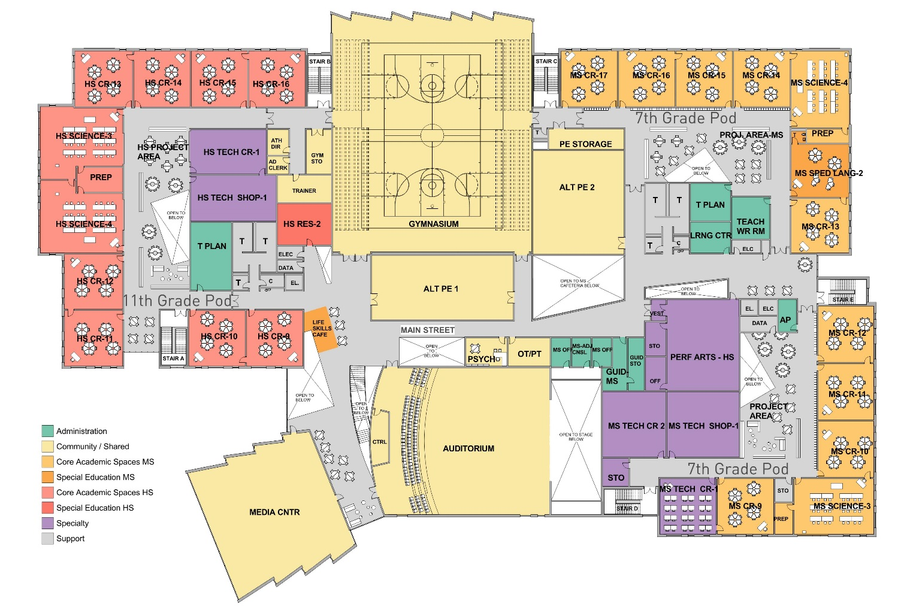
Project Update Second Floor Plan

Slide 9
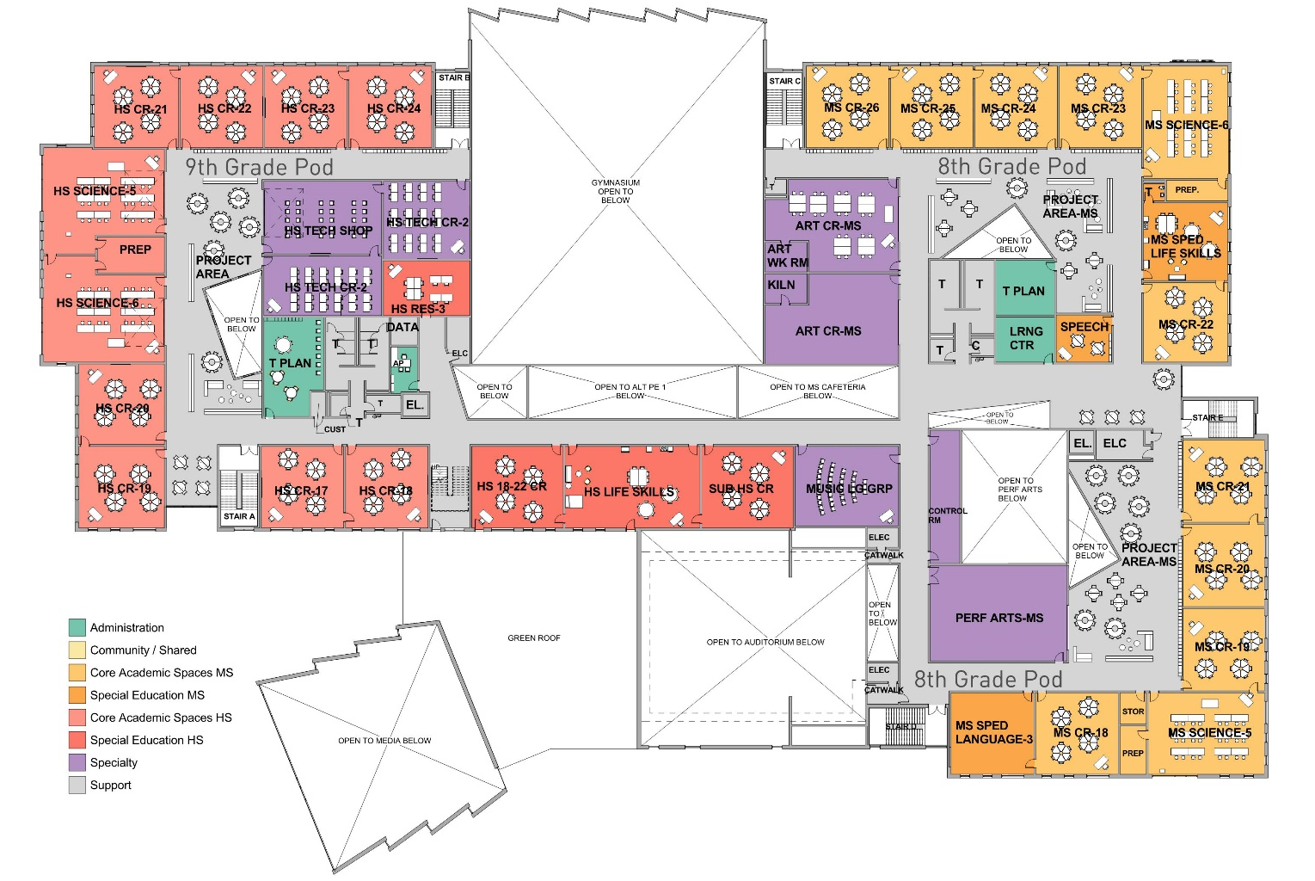
Project Update Third Floor Plan

Slide 10
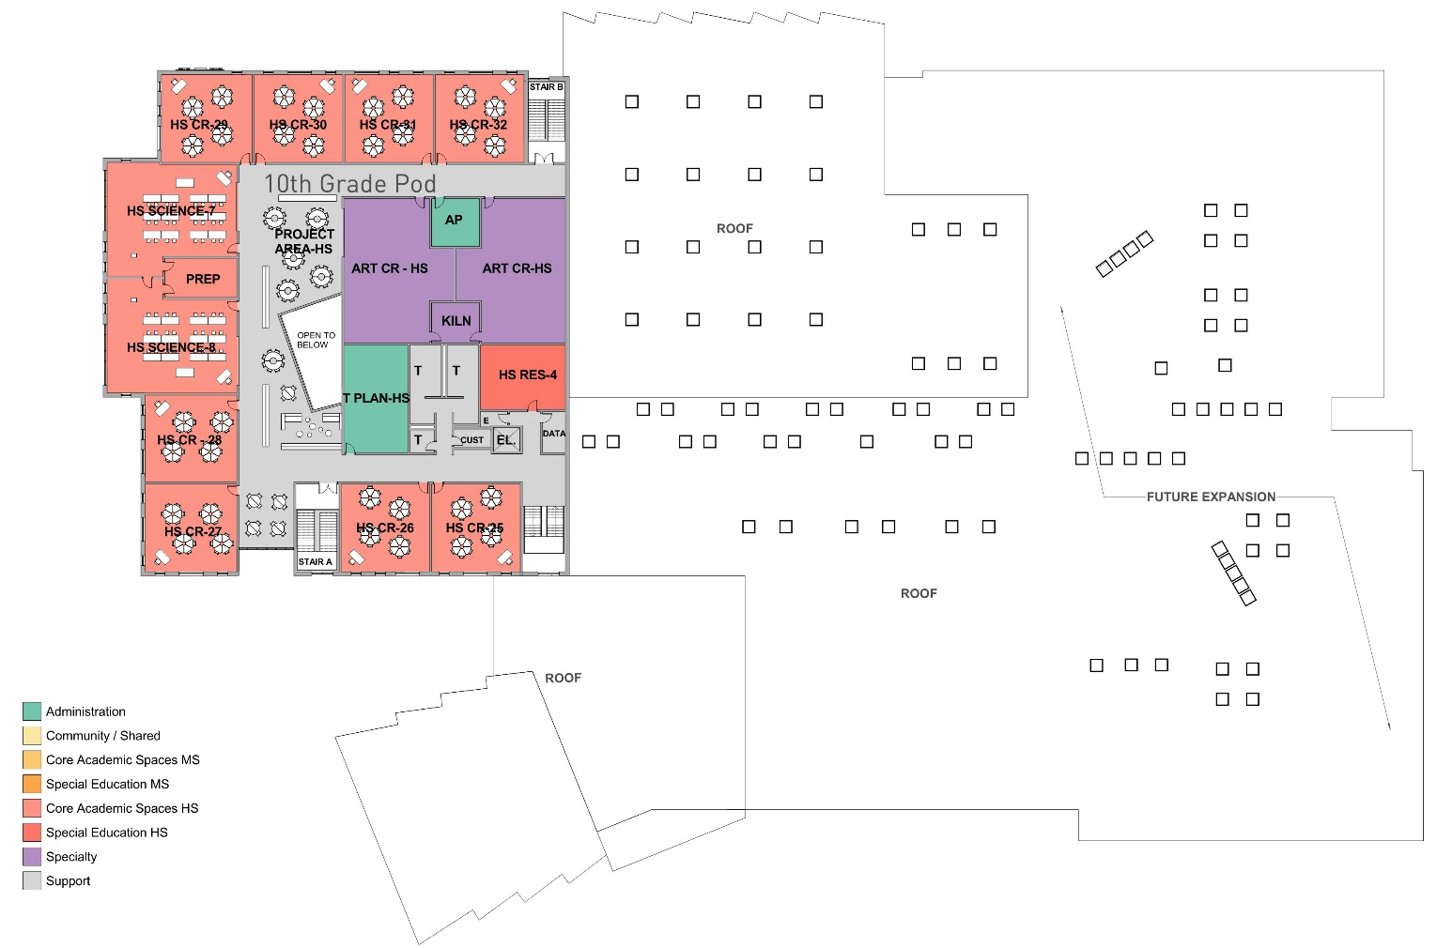
Project Update Fourth Floor Plan

Slide 11
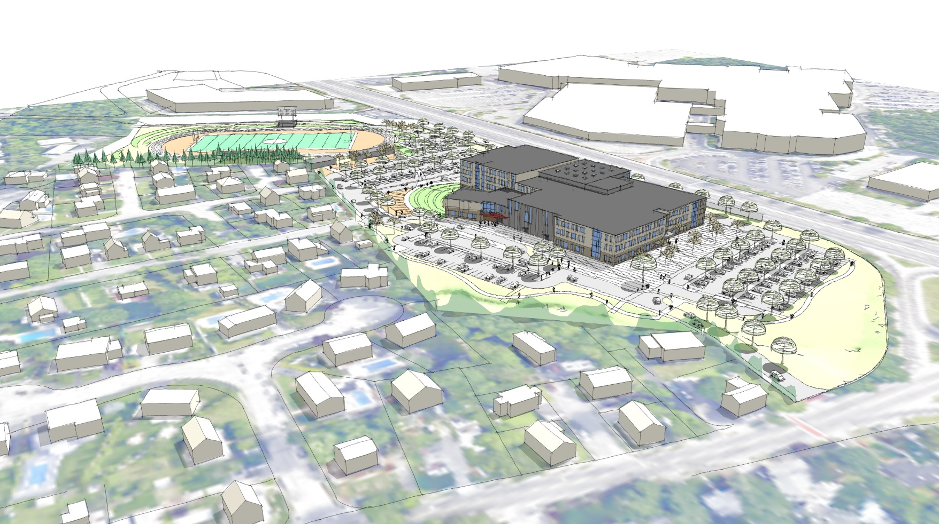
Project Update Massing Studies

Slide 12
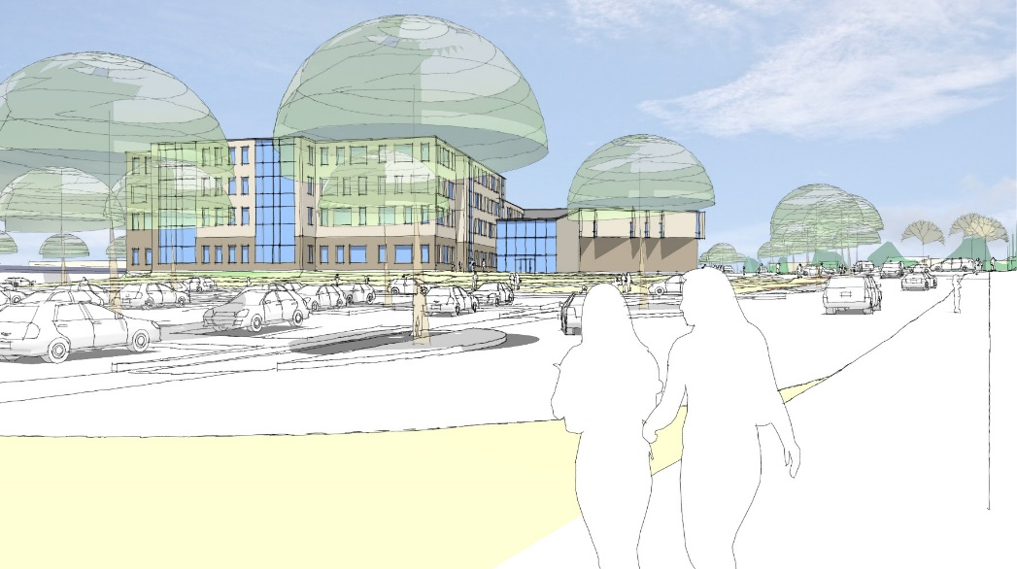
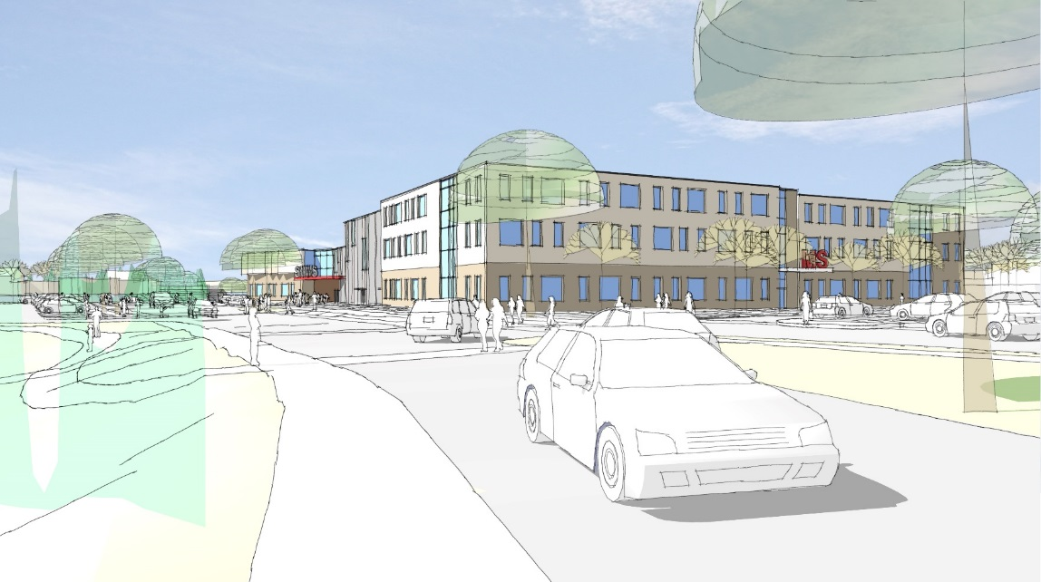
Project Update Exterior Perspectives
Pierce Memorial Drive Entrance View
High School South View

Slide 13
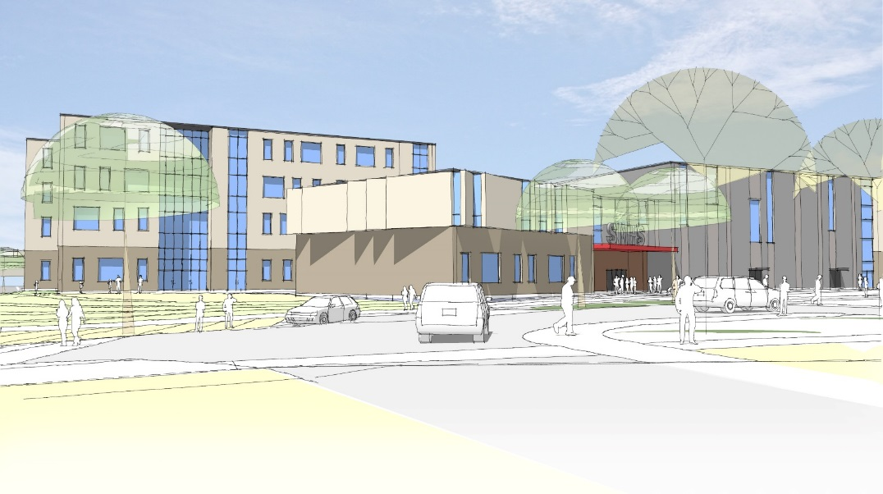
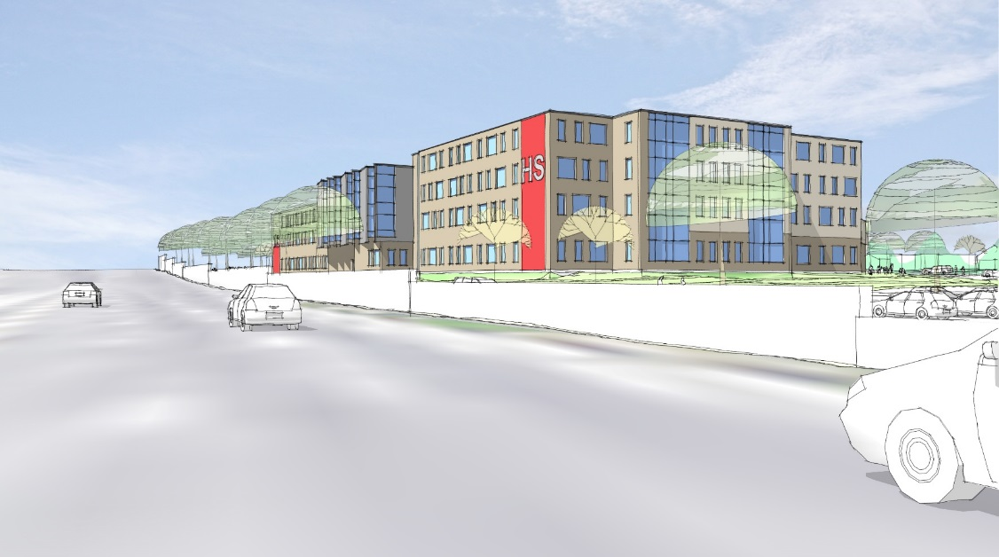
Project Update Exterior Perspectives
Route 1 View
Highland Avenue View

