Slide 1




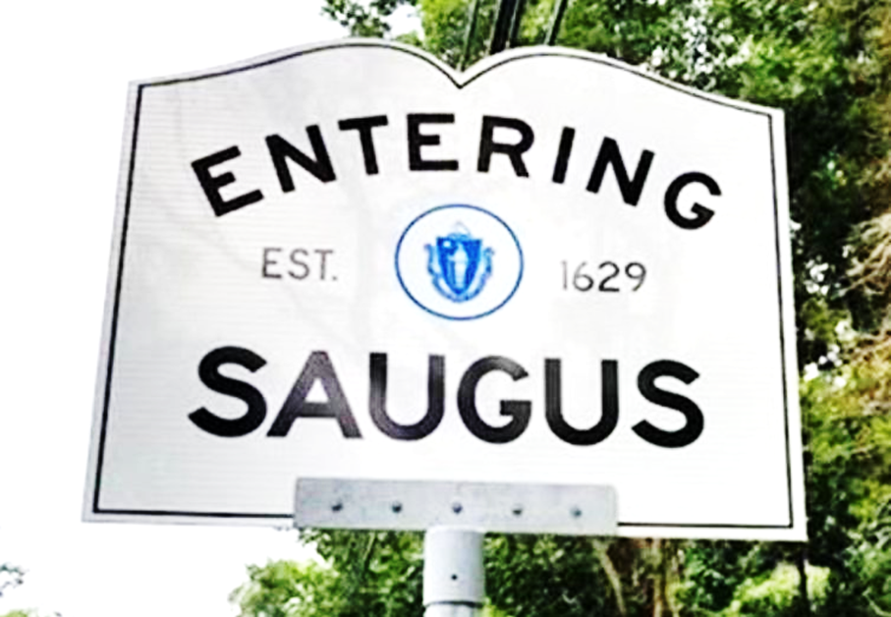

Saugus
Hazard Mitigation Plan 2021
Saugus Planning Board
June 3, 2021
Martin Pillsbury
Metropolitan Area Planning Council

Slide 2
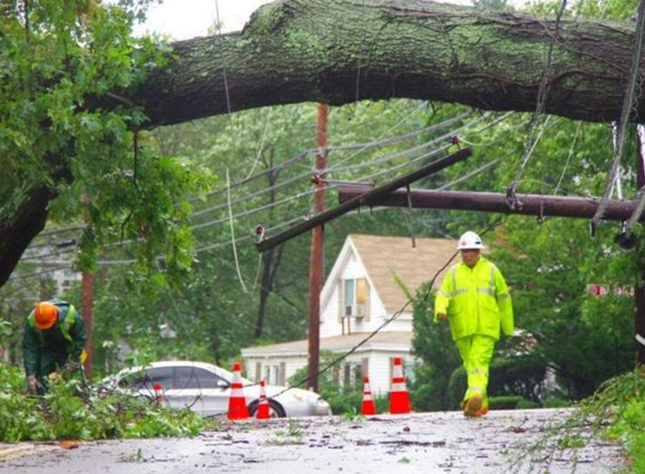
Why is Saugus doing this Plan?
The Federal Disaster Mitigation Act of 2000 requires towns to adopt and periodically update a Hazard Mitigation Plan to be eligible for FEMA mitigation grants.
Saugus’ previous plan was approved in 2015 and now must be updated
This 2021 Plan Update will meet FEMA’s requirement and make the Town eligible for FEMA mitigation project grants
Hurricane Irene
Source: https://saugus.wickedlocal.com
Notes:
This plan is being done because of a law enacted in 2000 – the Federal Disaster Mitigation Act.
There are certain categories of grants that can help cities like Everett implement strategies to address natural hazards like flooding and hurricanes.
But the Federal govt. wants to be sure money is well spent so DMA 2000 says that every community that wants to apply for grant money has to have a plan.

Slide 3

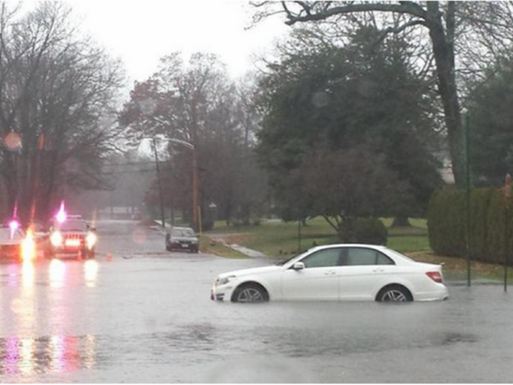
A Plan for Mitigating All Natural Hazards
Flooding
High winds, hurricanes, tornadoes
Winter storms, snow & ice
Brush fires
Earthquakes, landslides
Extreme temperatures
Drought
A Mitigation Plan , not an Emergency Response Plan
Notes:
This plan is being done because of a law enacted in 2000 – the Federal Disaster Mitigation Act.
There are certain categories of grants that can help cities like Everett implement strategies to address natural hazards like flooding and hurricanes.
But the Federal govt. wants to be sure money is well spent so DMA 2000 says that every community that wants to apply for grant money has to have a plan.

Slide 4

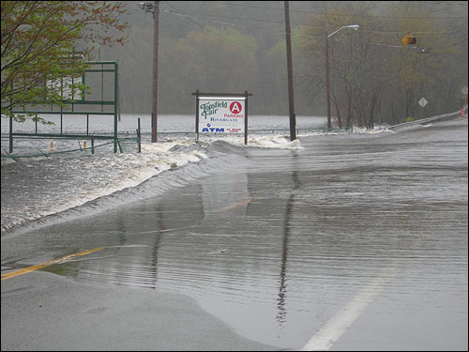
What is Hazard Mitigation?
To reduce or prevent loss of life, injuries and property damage by using long-term strategies before a disaster happens
(“Pre-Disaster Mitigation”)
What preventive actions are being taken NOW to reduce future risks and damages?
What additional actions can be taken in the FUTURE to reduce vulnerability and increase resilience?
Notes:
Hazard mitigation is just a fancy term for all the things that the city can and does to to lessen the impact of natural hazards on buildings, people and services in the City. It can include regulations such as zoning, structural measures such as retention basins and new drain pipes, educating property owners about hurricanes, etc.
As we’ll see in a few minutes, the City is already doing quite a bit.

Slide 5
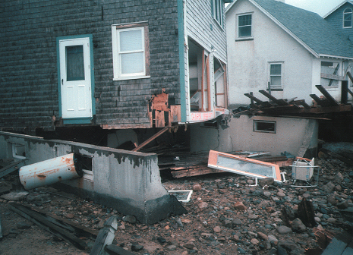
Mitigation: Breaking the Cycle of
Disaster & Rebuilding
Rebuild
Disaster
Disaster
Rebuild

Slide 6
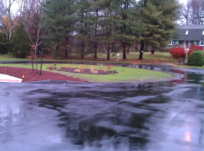
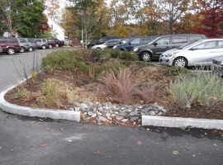
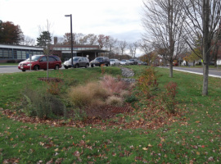
Six Tools & Techniques for
Hazard Mitigation
    Prevention
    Property Protection
    Public Education
    Natural Resources Protection
    Structural Projects
    Emergency Services Protection

Slide 7
How the Plan is Developed
8. MEMA & FEMA Plan Approval & Town Adoption
1. Hazard Identification & Mapping
7. Second Public
Meeting-Draft Plan
2. Inventory & Map Critical Facilities
Local
Core Team & MAPC
6. Recommend
Mitigation
Strategies
3. Assessment of Risks & Vulnerabilities
5. First Public Meeting-
Plan in progress (3/18)
4. Review Existing
Mitigation

Slide 8
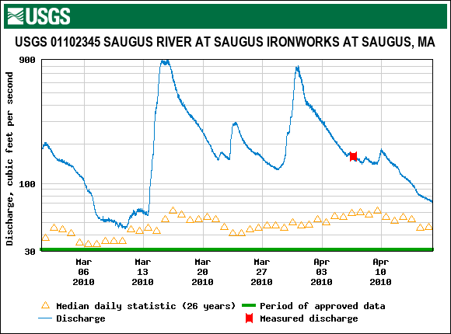
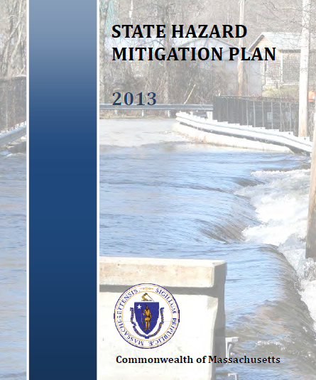
Hazard Identification & Mapping
State & Federal data on
floodplains, precipitation,
wind speeds, hurricanes earthquakes
Coordinate with Local Team
to get local hazard information
Flood Hazard Areas
Geologic Hazard (Earthquakes)
Wind Hazards (Hurricanes)
Winter Hazards (Snowfall, Ice)
Brushfire hazards
Drought
Extreme Temperatures

Slide 9
Critical Facilities
96 Sites identified including:
Disaster response sites such
as fire and police stations
Sites requiring assistance,
such as elderly housing
Infrastructure: Dams, pump stations, communications
Hazard Areas
24 Local flood areas
5 Brushfire risk areas
Notes:
The first step of course is to understand what the risks are.
Used statewide data (floodplains, average snowfall, landslide risk)
Point to map series on the wall.
Also mapping critical infrastructure to see where it lies in relationship to hazards.
Looked at statewide plan as well because of information on hazards in MA.

Slide 10
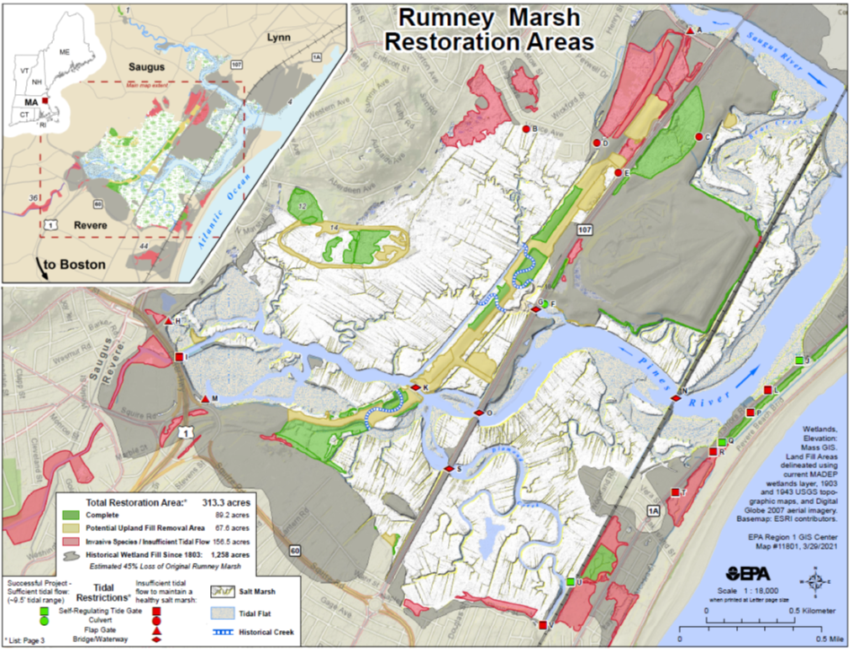
Rumney Marsh
2274 acres, extensive saltmarshes & mud flats, designated ACEC 1988
Historic fill/drainage alterations led to tidal restrictions, erosion, flooding
Salt Marsh Restoration Plan identified restoration projects, EPA tracking 44 projects over 20 years
EPA water level study in 2019 shows impact of the highway embankment on E. Saugus drainage
Rt. 107 bridges are key tidal
restrictions to the upper estuary

Slide 11
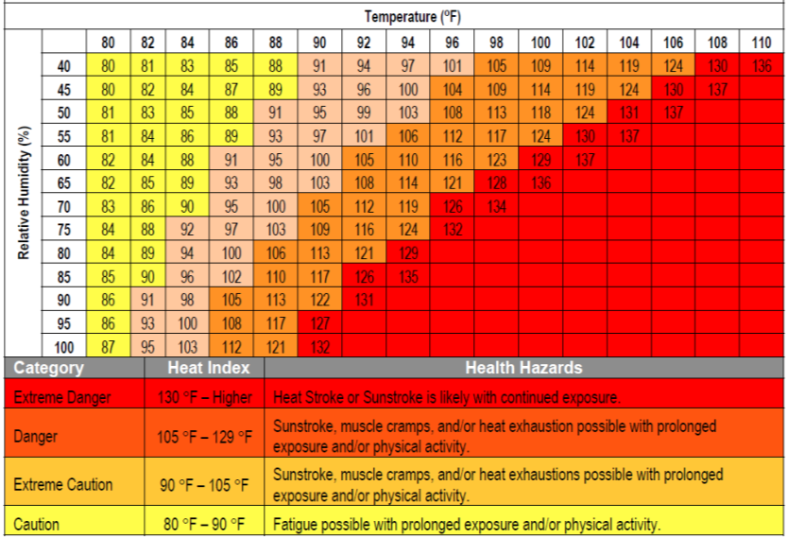
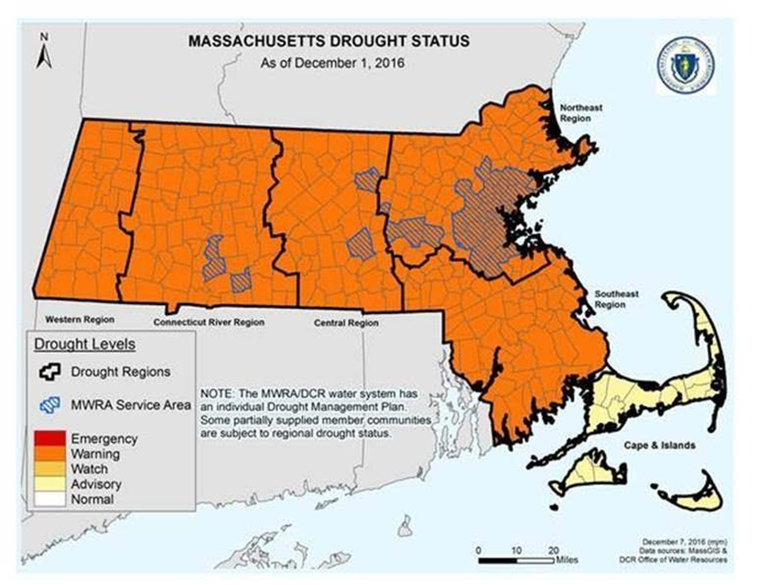
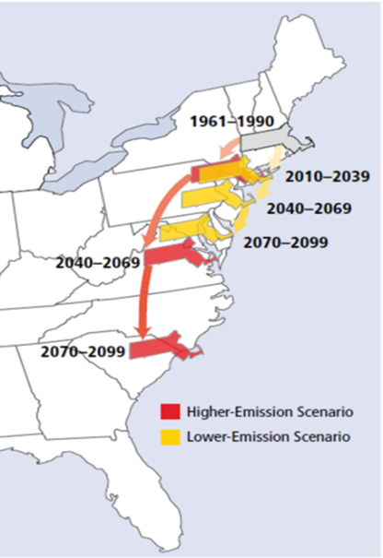
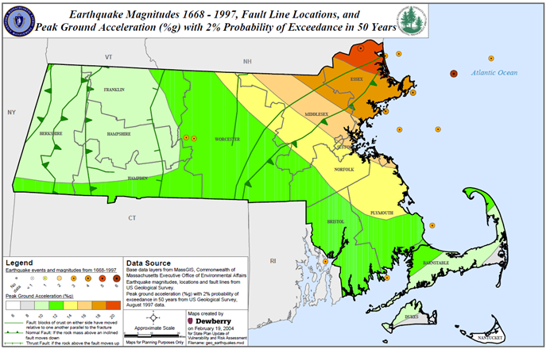
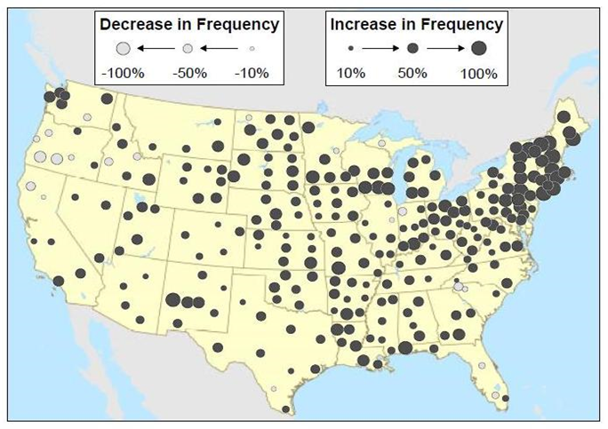
Multiple Natural Hazards
Extreme Heat
Drought
Future Climate Trends
Earthquakes
Extreme Precipitation

Slide 12
Vulnerability Analysis: Estimated Damages
FEMA’S HAZUS-MH Program
HURRICANE Estimated Damages
100-Year Hurricane property damage: $ 17,318,000
500-Year Hurricane property damage: $ 87,541,000
EARTHQUAKE Estimated Damages
Magnitude 5 total property damage: $ 602,840,000
Magnitude 7 total property damage: $ 4,239,000,000
FLOODING Estimated Damages
100-Year Flood property damage: $ 164,570,000
500-Year Flood property damage: $ 478,060,000

Slide 13
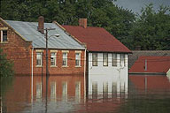
Mitigation Strategies
The Mitigation Strategies
from the previous plan were
updated by the Local Team
considering the following:
What are the Town’s existing Mitigation measures?
Where are the gaps? What additional actions will further reduce vulnerability?
What are the mitigation priorities, costs, timelines?
Review priority actions from the MVP Workshop.

Slide 14
Updated Mitigation Strategies
High Priority Mitigation Measures
1. Complete design and construction of Route One drainage system upgrade
2. Update East Saugus drainage system
3. Consider adopting a Stormwater Utility mechanism
4. Additional manpower resources for storm preparation and response
5. Replace the Spring St. 48-inch culvert with a larger, pre-cast concrete culvert
6. Upgrade drainage lines along Lynnhurst Street from Stockade Road to Elm St.
7. Acquisition of Vacant Flood Prone Lands
8. Install generators at Town Hall and Senior Center

Slide 15
Updated Mitigation Strategies
10. Local Drainage upgrades from the Drainage Master Plan:
Belair and Hewlett Streets Bistrow Street area Sachem Street Spring Street culver Bennetts Pond Brook Hayward Street culvert Forest Avenue Fairmont Avenue Shute Brook culvert at Vine St. | Auburn Street wetlands Acadia and Aberdeen Ave. Central and Mt. Pleasant St. Sycamore Lane Pleasant Avenue Essex Street Maple Road Altamont Avenue

Slide 16
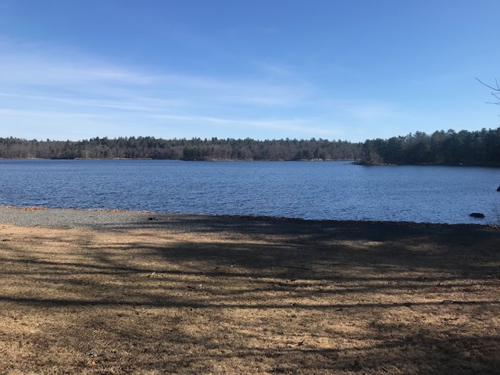
Final Steps: Hazard Mitigation Plan
Plan Review by MEMA and FEMA
Submit revisions if required
Town Adoption of the plan
FEMA Approval: the Town will be eligible for FEMA grants for 5 years

Slide 17
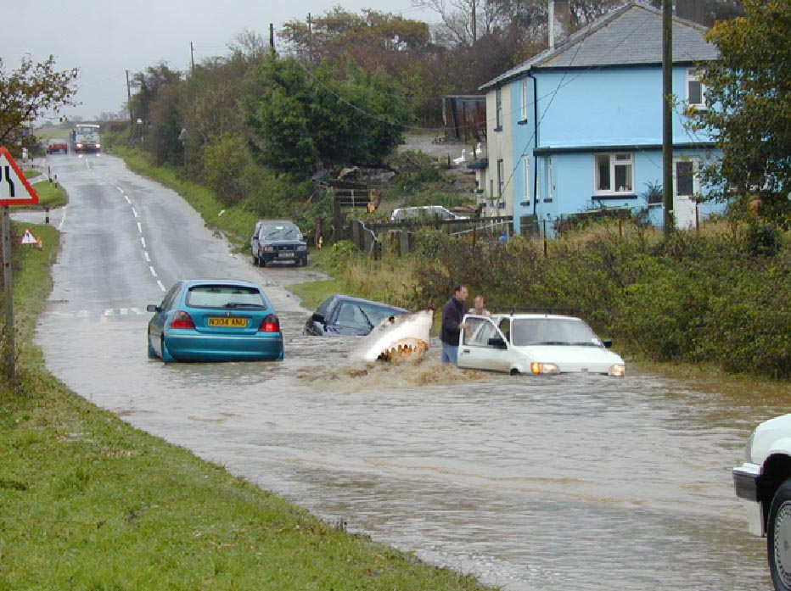
Questions ?
Notes:
17
Most of what we found was areas of flooding.
Flooding in general not caused by location in floodplain but by inadequacies in drainage system.

Slide 18

Draft Plan Available Online
Here is a link to download the draft
Saugus Hazard Mitigation Plan 2021 Update:
https://www.saugus-ma.gov/planning-and-economic-development
Please submit any questions or comments by
June 17 to amello@saugus-ma.gov
Notes:
I will start with the brief overview on the concept of climate warming.
Solar energy comes in from the sun and some heat is radiated back to space.
But some is trapped by gases in the atmosphere that function like a blanket holding heat in.
That is what keeps the planet’s temperature regulated.
Without these gases, the planet would be too cold to support life.
Industrialization has meant a tremendous increase in the concentration of gases in the atmosphere because of the combustion of fossil fuels.
Typically, people refer to these gases as greenhouse gases.
Generally, we talk about C0² the most, because it’s the most abundant of the gases.

